Slide 1
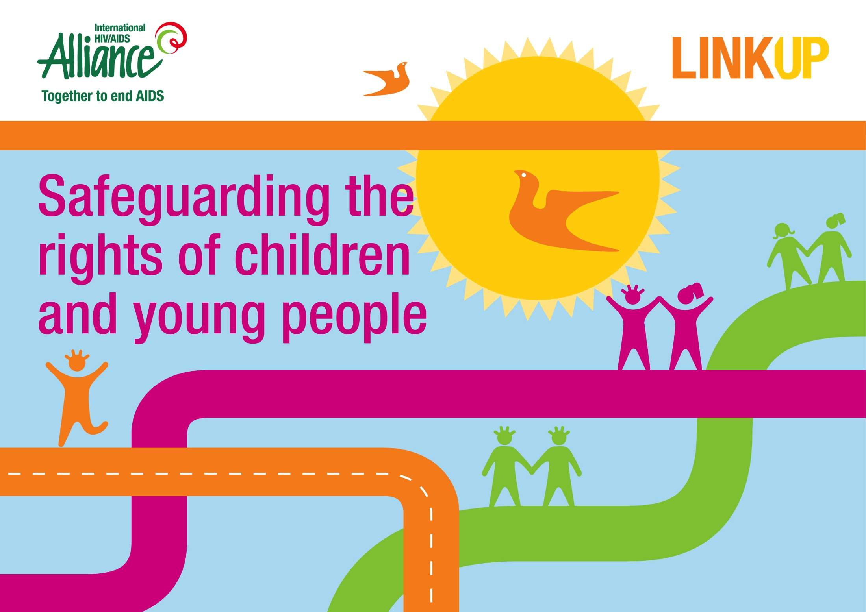

Slide 2
Objective
To build capacity of staff and partners on safeguarding children and vulnerable young people in the implementation of the project.
Outputs
The participants will have had the opportunity to:
reflect on the dilemmas they face in their work
understand the importance of safeguarding the rights of vulnerable children and young people
become familiar with tools to help decision-making and safeguarding in programmes with vulnerable children and young people

Slide 3
Scenario 1
A 14-year-old girl comes to the clinic to ask for an abortion. She comes alone and tells you that she has become pregnant through sex with her teacher.
She doesn’t want you to tell anyone because she will be thrown out of school if she is discovered to be pregnant. She cannot talk to her parents as the shame would be too great.
What would you do?
Notes:
What would your reponse be?
What would you base your decision on- law, ethics, best interest, clinic , policy, religious values?
What does that child need from you? Service, understanding, non judgemental, protection, links to other services, legal action against the school
How do you know what she wants? Does it matter?

Slide 4
Scenario 2
A 15-year-old boy attends your clinic and asks for an HIV test. While talking to him, you discover he is unsure about his sexuality and his parents have thrown him out for being too effeminate.
He also tells you he is living with a 50-year-old man who he says loves him, is helping him learn about his sexuality, and who shelters and feeds him.
What would you do?
Notes:
What is your biggest concern here? What makes you uncomfortable?
His sexuality? His intergenerational relationships? his parents rejection? his HIV risk, his sexual health? His security? His opinion?

Slide 5
Scenario 3
A father brings his 12 year old daughter to the clinic for an examination to ensure she is ‘intact’ for her impending marriage.
What would you do?
Notes:
Each scenario raises issues over the rights of a child to their right to choose and also the need to protect them.
They present challenges of the involvement of parents and the need for follow on activities- child protection, schools, addressing child marriage, exploitation by adults.
They are difficult and mixed with our attitudes our beliefs as well as what is legal, acceptable , just, ethical

Slide 6
Scenario 4
A 15-year-old girl had been coming to your centre for STI screening and condoms. You suspect she is selling sex but she will not discuss it. You have asked her about her parents but she says they don’t care about her.
One day she arrives at the centre with her parents and they tell you that she has given birth but she will not reveal the name of the father. There must be a father’s name on the birth certificate because without it the child has no identity and cannot access health, education or welfare services.
The parents tell you not to help her unless she reveals the name of the father and the baby can be officially registered. You understand that the girl may not know who the father is or be able to reveal his identity. Legally, the parents have the right to decide the services that their daughter should or should not receive.
What would you do?
Notes:
A 15 year old girl had been coming to your centre for some months for STI screening and condoms. You suspect she is selling sex but she will not discuss it. You have asked her about her parents but she says they don’t care about her.
After some months the girl arrives at the centre with her parents and they quickly tell you that she has given birth to a baby but that she will not reveal the name of the father.
In order to register a child there must be a father’s name on the birth certificate, without a name the child has no identity and can not access any health , education or welfare services.
The parents tell you not to help her unless she reveals who the father of the child is and the baby can be officially registered.
You understand that the girl may not know who the father is and that even if she does she may not be able to reveal his identity but you also realise that the baby has a right to an identity and to access support.
Legally the parents have the right to decide the services that their daughter should or should not receive.
What should you do? How will you decide?
own sense of morality Inconsistency in processes from one worker to the next; Lack of support for care worker to manage moral distress and moral residue policies but they are insufficient, The danger that not all options will be fully explored,

Slide 7
Group work questions (20 minutes)
What issues are key in this scenario?
What makes this situation difficult to deal with?
Whose desires/ needs/ rights are in conflict with another persons?

Slide 8
Plenary questions (25 minutes)
How did these scenarios make you feel?
Are they similar to what you or your partners currently have to deal with?
What are the implications for our work?
What tools experience do we currently have to address situations like this?
Notes:
Reflection : what makes it difficult – my values, beliefs, lack of guidance, fear of consequences?
conclusion: this is tough, there is no right answer, there are different barriers some internal and some external, we need tools and guidance to do this better.

Slide 9
Child rights
The best interest principle requires us to consider the child’s perspective no matter the age of the child.
The concept of the evolving capacities requires adults to assure that the child who is capable of forming his or her own views has the right to express those views freely and that the views of the child are given due importance in accordance with the age and maturity of the child.
Evolving capacities recognizes that as children become more competent there is less need for direct protection and a greater need for autonomy that they can take responsibility for decisions affecting their lives..
Respect for children’s rights demands that we nurture the evolving capacities of every child and also that we present all children with the largest range of choices in order for them to have rich, full lives.
Both the best interests of the child and the child’s evolving capacities must be taken into consideration in all decision-making related to children.
Convention on the Rights of the Child: www.unicef.org/crc/files/Rights_overview.pdf
Notes:
3 There must be recognition that children in different environments and cultures, and faced with diverse life experiences, will acquire competencies at different ages

Slide 10
Child safeguarding and protection
The aim of child safeguarding is to prevent and respond to violence, exploitation and abuse against children but also to provide and safe and healthy environment for children to grow and develop.
Child protection involves measures and structures, laws and policies that keep children safe from harm, including physical, sexual, psychological or emotional abuse and protects children from all forms of exploitation
But protecting children can also result in actions by adults to control the actions and decisions of children based on a principle of protecting them from harm.
While it is important to consider the things we can do to mitigate harm it is important to remember that protection is also necessary for children to develop autonomy and make their own decisions.

Slide 11
What will you do?
A young female client has accused an adult client of making sexual advances towards her while she was attending your centre she does not want anyone to know it was her.
In a focus group discussion about your services a child says they don’t like a specific outreach worker. All the children nod and agree but won’t say anything more.
A colleague comes to you and says there is a staff member he has seen out with a young girl at the weekend he believes to be around 16 years old
A staff member reports that one of the clients called him late last night desperate for somewhere to stay as his parents had thrown him out of home. He offered him an bed for the night but the parents have now called the police.

Slide 12
Child protection vs autonomy
Protection and autonomy are not in opposition
As children grow and develop we need to strive to protect a space for children to make their own decisions and build their capacity for self-protection.
Parental right should not come above a child’s right to make his own decisions when he reaches a sufficient understanding and intelligence to be capable of making up his own mind.
Adults will have different opinions about when a child has the ability to make their own decisions. It is important that as an organisation you have thought carefully about how you will assess a child's ability to make choices about services and consent to interventions.
Notes:
Too often protection and autonomy are presented as principles in opposition- adults who know better protect children from danger, preventing them from making bad decisions in their 'best interest' but it is key that as children grow and develop that we strive to protect a space for children to make their own decisions and build their capacity for self-protection.

Slide 13
Agree or disagree?
I don’t ask the age of a young person who is requesting services because then I cannot be held responsible.
I should seek parent/caregiver consent before I offer a service to a 14-year-old.
We should be prepared to break the law if we want to help young people.
Involving parents is always a problem and should be avoided.
I have to keep promises to young people. I would never break their trust and confidence.
Children have rights that must be the top priority in my decision-making.
Our ultimate goal should be to get the children we see to stop doing the things that put them at risk.
Children are too young to know what is in their own best interest.
Children who access our services have the same right to confidentiality as the adults.

Slide 14
Legal environment
The legal and policy environment in which we work can strongly influence the way we interact and engage with most at risk young people.
It is important to assess the legal environment in which you work – age of consent, parental consent requirements, access to services for under 18s, provision of sexuality education and contraception.
Ask
Is the service needed?
What risks are there in not providing it?
What risks are there in providing it?
Do risks to children and young people outweigh the risks to the organisation?
Notes:
We may believe that certain activities or providing certain services are illegal or may get us in trouble with the authorities.
This can shape our attitudes to providing these services.
What examples do you have from your own countries around legal restrictions?
Discussion

Slide 15
Assessing capacity
Assessing capacity of children and young people to make decisions
Fraser guidelines
Does the young person understand what is being provided or suggested, and the rationale for the products/ service?
Does the young person refuse to provide parental consent?
Is the young person likely to continue risky behaviour or to remain in a risky environment?
Is the young person’s physical or mental health likely to suffer if the products/ services or not provided?
Are the young person’s best interests served by providing the products/ services?
Notes:
One tool that will be helpful for you are the Fraser Guidelines which help assess whether a child has the maturity to make their own decisions and to understand the implications of those decisions. A court ruling by Lord Fraser in the UK gave rise to the guidelines but the guidelines have universal relevance:
"...whether or not a child is capable of giving the necessary consent will depend on the child’s maturity and understanding and the nature of the consent required.
The child must be capable of making a reasonable assessment of the advantages and disadvantages of the treatment proposed, so the consent, if given, can be properly and fairly described as true consent.
Parental right yields to the child’s right to make his own decisions when he reaches a sufficient understanding and intelligence to be capable of making up his own mind on the matter requiring decision”.
Court ruling by Lord Fraser

Slide 16
  Role play
  An 11-year-old asks for an HIV test.
  A 17-year-old girl who sells sex asks to be sterilised.
  A 16-year-old boy wants to take an HIV treatment ‘holiday’.

Slide 17
Thank you

