Slide 2
Day 1: Session 1
Welcome
Icebreaker: BINGO!
(Don’t forget to introduce yourself to the people you talk to …)

Slide 3
Session 2: Setting our hopes and expectations
Why is mentoring important?
What are your experiences of mentoring
What hopes and expectations do we want to achieve by the end of the training?

Slide 4
Session 3: Advocacy and participation
Exercise: in pairs discuss a time when you were not able to make a decision or act in the way you wanted to. What stopped you?
See Handout 5: Flower of Participation:
What are the barriers to meaningful participation?
How can these barriers be removed?
What type of mentorship would strengthen youth involvement in advocacy work?

Slide 5
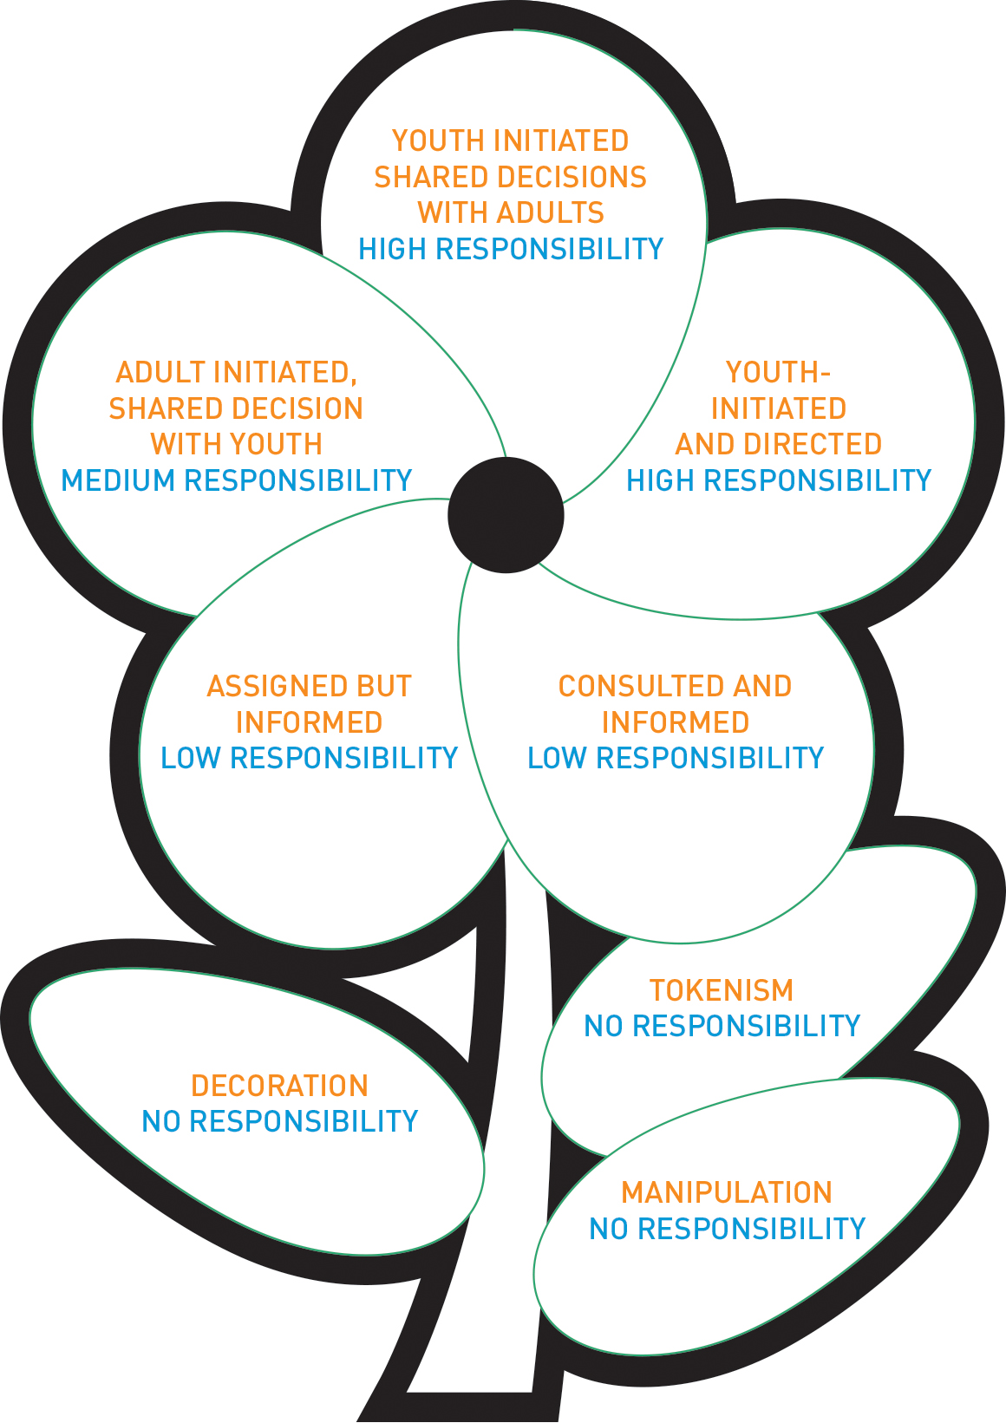
Session 3: Flower of Participation

Slide 6
Session 4: What is mentorship?
“A mentor is a person or friend who guides a less experienced person by building trust and modelling positive behaviours. An effective mentor understands that his or her role is to be dependable, engaged, authentic, and tuned into the needs of the mentee.”
Does this capture everything? What would you add or change?
What other objectives for mentorship are there?

Slide 7
Session 6: Closing day 1
Any questions?
Any issues with hotel, travel, per diems?
Are there any car park issues we haven’t addressed, or anything you’ve thought about but not added?
What to expect from day 2? Checking in: anything we’ve missed, not focused on enough or any problems so far?

Slide 8
Our agreed objectives
(Fill in together)
Notes:
These were the agreed objectives from the Kampala workshop, in case prompts are needed:
To improve our knowledge of mentoring, including: the difference between mentors and mentees, what makes a good mentor, when to start mentoring, whom to mentor and where to mentor, the possible challenges faced by mentees and mentors and the roles and responsibilities of mentors and mentees.
To gain skills and build capacity so we can take part in mentoring, including public speaking, and understanding of different concepts.
To understand the difference between advocacy and mentoring, and how mentoring can support people to become or improve as advocates.
To identify mentors and mentees and create a working relationship, establish trust and confidentiality, and start developing our work plan.
To develop a mentoring tool to be a guideline for other young people and create a draft mentorship programme.

Slide 9
Day 2: Session 1
Planning our mentoring work

Slide 10
Session 8: Setting roles and expectations
What are we looking for in a mentor? (Refer to Session 5)
What do we expect from a good mentor?
How can we support mentors?
What is the role of the mentee? What qualities do they need to have?

Slide 11
Session 8: How should mentors and mentees be matched?
What matters to you?
Age
Gender
Geography
Personal relationship
Key population
Gender
Other?

Slide 12
Session 9: Starting from our strengths
Head: What knowledge do you have?
Hands: What skills do you have?
Heart: What are you passionate about?

Slide 13
Session 10: Putting mentoring into action
Setting personal goals for the mentorship – what specific things do you want to do?
What is the purpose of the mentorship?
How long will the mentorship last?
How will you meet your goals?
How will you measure success?
How and when will you communicate?

Slide 14
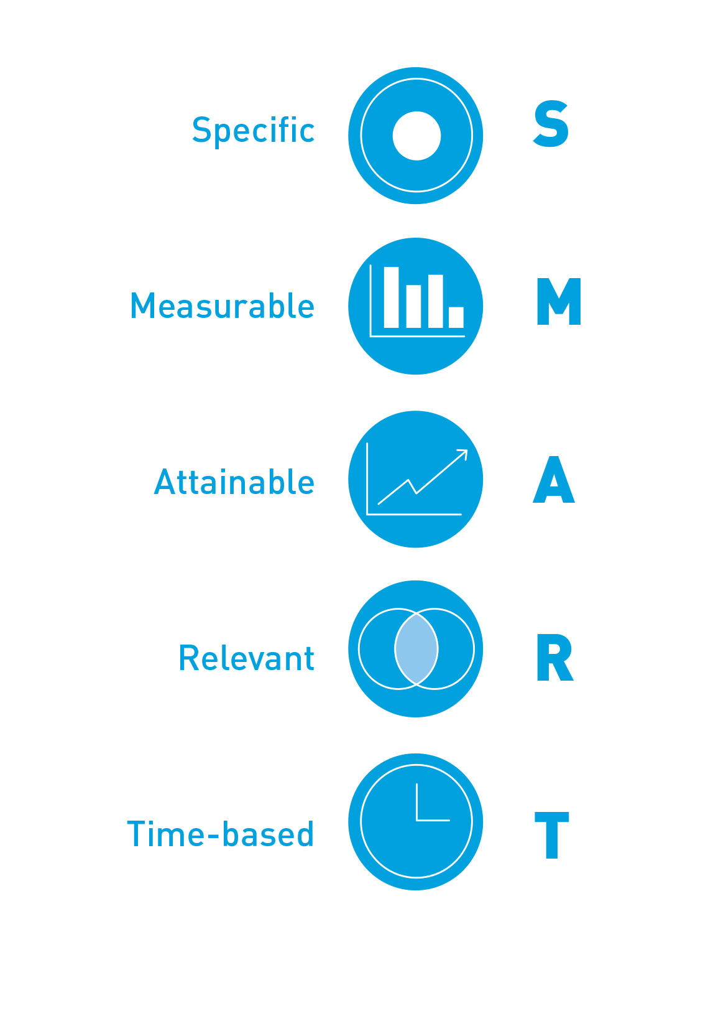
Session 11: Setting our “SMART” advocacy aims

Slide 15
Session 12: Self-care and setting boundaries
“Caring for myself is not self-indulgence, it is self-preservation, and that is an act of political warfare”
Audre Lorde

Slide 16
Session 13: Closing Day 2
Any questions?
Any issues with hotel, travel, per diems?
Are there any parking lot issues we haven’t addressed, or anything you’ve thought about but not added?
What to expect from day 3? Checking in: anything we’ve missed, not focussed on enough or any problems so far?

Slide 17
Day 3: Session 14 and 15
Reflecting on what we have learnt
Mentoring in action

Slide 18
Session 16: 10 tips for successful mentoring
What are your 10 tips to make mentoring work?
What would you like to share with other youth advocates around the world who can learn from your experience?

Slide 19
Our top 10 tips for mentoring
Notes:
These are from Uganda:
Mentoring is a process of imparting skills, knowledge, values and attitudes in a mentee by a mentor
Mentoring is a collaborative process where the mentor guides the mentee into positive behavioural change and to develop skills and abilities
Mentoring is the process of supporting people to take part in making positive change to policies and activities
A mentor is a more experienced person or friend who helps a less experienced person to have trust and confidence, and motivates positive behaviour
A mentor should be tuned to the needs of the mentee, and be dependable, reliable, authentic, non-judgmental and supportive

Slide 20
Session 17: Closing Day 3
Any questions?
Any parking lot issues?
Review and discuss next steps for mentoring

Slide 21
Thank you!

