Slide 1
3
Module 3
Gender-based violence
Integrating harm reduction and sexual and reproductive health and rights

Slide 2
Module 3 Gender-based violence
LEARNING OBJECTIVES:
2 hrs 10 mins
To understand the importance of primary prevention and to identify signs and symptoms of gender-based violence
To draw a safety plan and social support mapping
To define a comprehensive package of quality post-violence care and referral services for women and gender nonconforming people who use drugs who experience gender-based violence and intimate partner violence

Slide 3
Module 3 Gender-based violence
1. Gender-based violence is not a huge problem, but became popular because there is international funding for it.
Notes:
1. FALSE. Gender-based violence has been described by the World Health Organization (WHO) as a global public
health problem of epidemic proportions and a fundamental violation of human rights.

Slide 4
Module 3 Gender-based violence
2. Worldwide, an estimated 1 in 3 women will experience physical or sexual abuse in her lifetime.
Notes:
2. TRUE. According to WHO data from 2013, one in every three women will be beaten, coerced into sex or abused in some other way during her lifetime.

Slide 5
Module 3 Gender-based violence
3. Most gender-based violence is perpetrated by strangers
Notes:
3. FALSE. Most perpetrators are intimate partners, defined as past or current spouse or sexual partners, although they are sometimes family members,
friends, acquaintances, strangers, teachers, doctors, colleagues, prison guards, rehabilitation centre staff, military, or police officers.

Slide 6
Module 3 Gender-based violence
4. Gender-based violence concerns only women and girls.
Notes:
4. FALSE: Violence against women and girls is one of the most prevalent human rights violations in the world. Although most gender-based violence is inflicted on
women and girls, men and boys can also be affected, particularly during childhood, and violence is more likely if they do not conform to social norms regarding
sexual orientation and gender identity. (Source: Lancet)

Slide 7
Module 3 Gender-based violence
There is no sexual violence between a married couple.
Notes:
5. FALSE Rape and sexual violence can occur between married couples, although many countries don’t acknowledge ‘marital rape’ as a crime. Sexual violence can occur from intimate partners who are female or male, and within relationships that are long-term or casual

Slide 8
Module 3 Gender-based violence
6. Child, early and forced marriage are types of gender-based violence.
Notes:
6. TRUE. Child, early and forced marriage are forms of gender-based violence. Child marriage is widespread: around 1 in 3 girls in low- and middle-income countries are married before they are 18. According to UNFPA, 37,000 child marriages happen every day. Child marriage is a violation of human rights. It compromises the development of girls (and boys). Moreover, it often results in early and/or unintended pregnancy and increases risks of maternal deaths, unsafe abortion, HIV, poor health, poor education and social isolation. (Sources: UNFPA/UNICEF).

Slide 9
Module 3 Gender-based violence
7. Sex workers are less likely to experience rape or sexual violence because it is their job.
Notes:
7° FALSE. Because of punitive laws, stigma and discrimination against sex work, sex workers experience a high level of violence in general, and sexual violence in particular, from clients and also from police, military etc. Sex workers who use drugs experience greater levels of police sexual violence and rape, harassment and abuse, including invasive strip and cavity searches. (Source: The Global Network of Sex Work Projects and the International Network of People who Use Drugs, 2015, Briefing paper: Sex workers who use drugs: experiences, perspectives, needs an rights, ensuring a joint approach)

Slide 10
Module 3 Gender-based violence
8. Women who use drugs are more likely to experience intimate partner violence than women in the general population
Notes:
8. TRUE. Data indicates that women who use drugs are more likely to experience intimate partner violence and non-partner sexual violence than women who do not. In places with harsh laws and policies on drug use and sex work, sex workers who use drugs experience overlapping layers of risk caused by the combined effects of criminalisation, stigma and discrimination – especially where compulsory rehabilitation exists.

Slide 11
Module 3 Gender-based violence
Definition of gender-based violence
GBV is any act of violence that is inflicted upon an individual because of his or her gender or sexual orientation.” (UNFPA)
Gender-based violence is a global public health epidemic that affects mostly women and girls but can also affect men and boys including transgender persons, especially if they don’t conform to gender stereotypes.

Slide 12
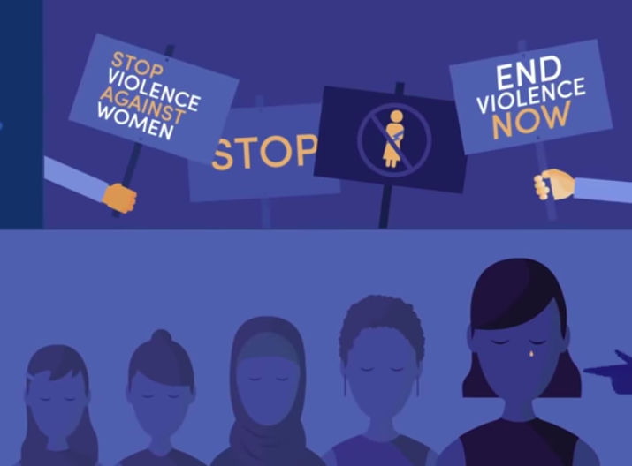
Module 3 Gender-based violence
Definition of gender-based violence
Gender-based violence is a violation of fundamental human rights, such as:
Right to life
Right to security and body integrity
Right to equal protection
Prohibition of torture and other cruel, inhuman or degrading treatment

Slide 13
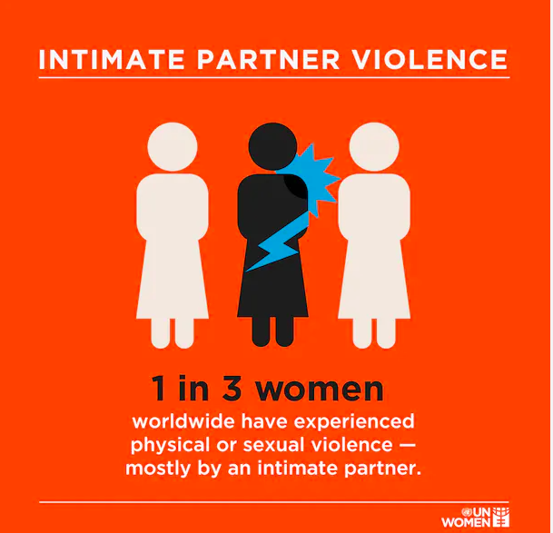
Module 3 Gender-based violence
Most perpetrators are intimate partners. Others are family members, friends, acquaintances, strangers, doctors, teachers, colleagues, military, prison staff, rehabilitation staff or police officers.
Classification according to 2 criteria:
1° Type of violence
2° Type of perpetrators or link between
the perpetrators and the victim/survivor.

Slide 14
Module 3 Gender-based violence
Case study:
20 mins
Identify and list the different signs or symptoms of gender-based violence
The types of gender-based violence the woman has experienced
Explain briefly what has been done
Report back:
15 mins

Slide 15
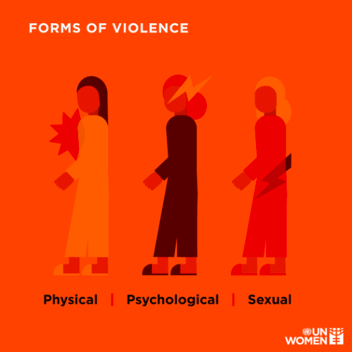
Module 3 Gender-based violence
Types of violence
Physical violence (hitting, kicking, slapping, restraining), and physical abuse (not giving HIV treatment or psychoactive substances to someone who is dependent).
Sexual violence (sexual abuse and rape, sexual sadistic pleasure at the expense of the partner, condom refusal). Lesbian women and other LGBT+ people face specific sexual violence, such as homophobic (or ‘corrective’) rape.
Emotional/psychological violence (stigmatisation, harassment, verbal abuse)
Economic and social violence (blackmail, discrimination)
Exploitation and trafficking, including sex trafficking
Harmful practices (female genital mutilation, honour killings, forced marriages, early marriages, sex-selective abortion)

Slide 16
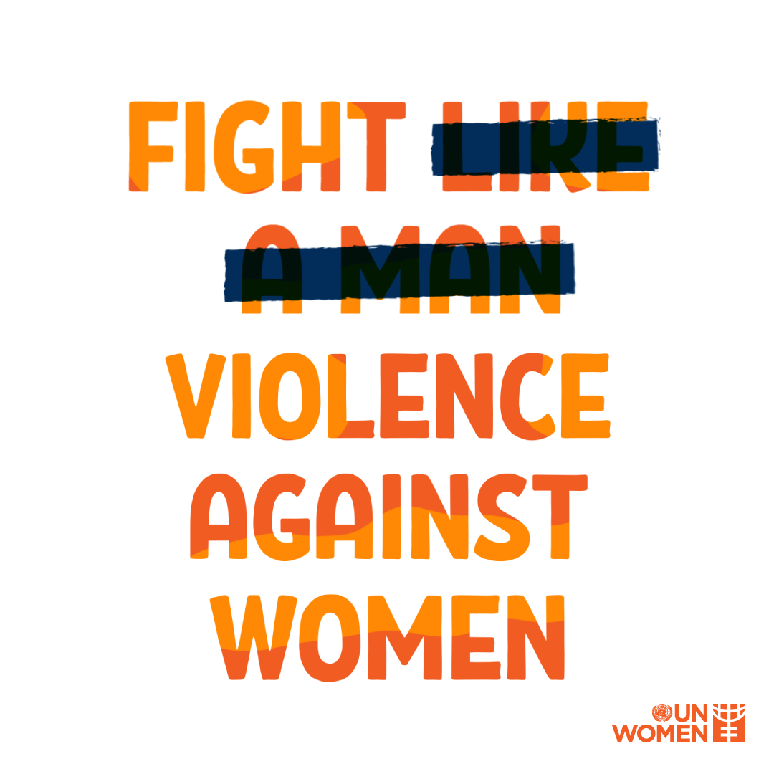
Module 3 Gender-based violence
Preparators of violence
Violence can be classified according to perpetrator categories:
Violence by an intimate partner
Violence by the family
Community violence
Institutional / state violence (includes violence by police, prison wardens and in health settings)

Slide 17
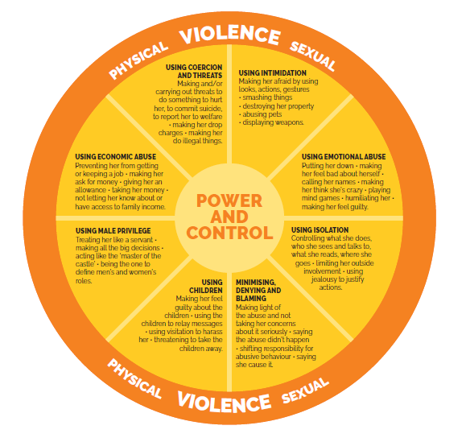
Module 3 Gender-based violence

Slide 18
Module 3 Gender-based violence
DEFINITION OF FEMALE GENITAL MUTILATION/CUTTING (fgm/c)
It comprises all procedures that involve partial or total removal of the external female genitalia, or other injury to the female genital organs (WHO)
FGM/C is performed early in life on girls (0–14 years)

Slide 19
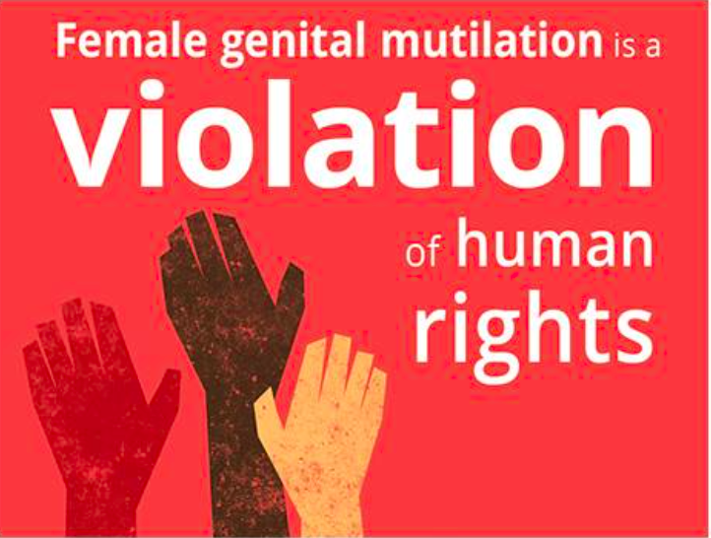
Module 3 Gender-based violence
DEFINITION OF FEMALE GENITAL MUTILATION/CUTTING (fgm/c)
It is a violation of human rights
Right to health
Right to security
Right to physical integrity
Right to to be free from torture and cruel,inhuman, or degrading treatment.
FGM/C is associated with a range of complications, including severe bleeding, problems urinating, infections, and complications in childbirth, and can lead to death.

Slide 20
Module 3 Gender-based violence
Consequences of gender-based violence
Physical consequences, such as chronic pains, STIs/HIV, unintended pregnancy
Psychological consequences, such as shame, depression, feelings of insecurity, guilt, PTSD
Socio economical consequences, such as exclusion, family rejection, loss of resources
Failure to address gender-based violence and intimate partner violence experienced by women and gender non-conforming people who use drugs increases the likelihood of continued drug use, relapse and leaving drug treatment programmes.
HIV and gender-based violence
Living with HIV is a risk factor for gender-based violence and gender-based violence is a risk factor for HIV transmission!

Slide 21
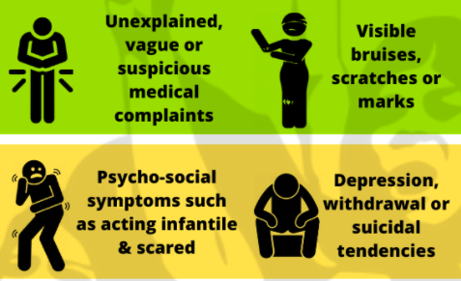
Module 3 Gender-based violence
SIGNS AND SYMPTOMS
Signs and symptoms of gender-based violence that can alert providers:
Chronic pain
Headaches
Sleep disturbances
Depression
Repeated consultations without apparent reason
Anxiety/stress
Withdrawn/aggressive behaviour
Signs and symptoms that are red flags
Vague complaints
Wounds and blow marks or injuries
Refusal to reveal the cause of injuries or wounds
A partner who is overly attentive or controlling
Physical injury during pregnancy
History of attempted suicide or suicidal thoughts
Delay between injury and the seeking of treatment

Slide 22
Module 3 Gender-based violence
Beware!
Women and gender non-conforming people often have reasons for staying in a violent situation. For example, fear of withdrawal if their partner gets them drugs.
Do not judge
Respect someone’s choices
Apply the ‘do no harm’ principle
Support someone to receive support and remain alive until they can get out of the situation of violence

Slide 23
Module 3 Gender-based violence
Draw a safety plan:
35 mins
Draw a safety plan and social support map
Individually
Take 10 minutes to start drawing the individual safety plan
In pairs:
Develop the social support map
One person plays the harm reduction provider, the other person plays the client
discussion:
10 mins

Slide 24
Module 3 Gender-based violence
World café:
20 mins
Working 3 groups
Provide a list of services / activities for
Primary prevention: before the violence occurs to reduce the occurrence of violence
Secondary prevention: comprehensive package of post-violence care and referral services for gender-based violence
Secondary prevention: comprehensive package of services for sexual violence, including rape
Change every 5 minutes and complete the list of the previous group
primary prevention services
secondary prevention package of post-violence care
secondary prevention comprehensive package services for sexual violence

Slide 25
Module 3 Gender-based violence
PREVENTION STRATEGIES!
What can be done?
Different prevention strategies:
Primary prevention: prevent gender-based violence before it occurs
Secondary prevention: reduce the short-term consequences of gender-based violence (within 72 hours for sexual violence)
Tertiary prevention: reduce the long-term consequences of gender-based violence
.

Slide 26
Module 3 Gender-based violence
PRIMARY PREVENTION
Community services to change social, economic and gender norms
Train harm reduction providers on gender-based violence
Group education for men and boys, combined with community outreach
Women-only safe spaces and/or times within harm reduction sites
Information and education materials to promote the post- violence support that is available
Established a roadmap and partnerships to support the specific needs of women and gender non-conforming people in all their diversity
Support people to develop a personalised safety plan and social support map
Advocate for domestic violence shelters to open their doors to women and gender non-conforming people who use drugs
.

Slide 27
Module 3 Gender-based violence
Secondary prevention: the comprehensive post-violence care package
Medical examination and follow up
Referral to /or provision of continuous psychosocial support, trauma therapy and counselling
Self-help groups
Referral to /or provision of protective orders and emergency shelters
Referral to/or provision of judicial support/accompany for a complaint
In case of rape and sexual violence in addition to the above services:
Emergency contraception and PEP for HIV prevention within 72 hours
Access/referral to safe abortion if needed
Screening and treatment for STIs
Referral to legal services, including medical examination and medical certificate

Slide 28
Module 3 Gender-based violence
Quality services
Quality is essential in offering services to survivors of gender-based violence. This means:
Confidentiality
A timely response, within 72 hours
Asking for consent
Prioritising safety
Avoiding questioning the survivor's word
Avoiding interrupting the person to ask questions
Not forcing the person to talk

Slide 29
Module 3 Gender-based violence
Critical enablers
Supportive legislation, policy and funding (including decriminalisation of drug use, drug possession and sex work)
Addressing stigma and discrimination
Availability, accessibility, acceptability (quality) and affordability of sexual and reproductive health services, including gender-based violence services for women and gender non-conforming people who use drugs
Enhancing women’s and gender non-conforming people’s community empowerment and engaging men to promote positive masculinity
Transforming social and gender norms
Addressing violence against women in all their diversity and gender non-conforming people

Slide 30
Module 3 Gender-based violence
Gender-based violence must be addressed in the context of seeking to end all forms of discrimination, to advance gender equality, and to empower all women and gender non-conforming people

