Slide 1
1
Module 1
Gender, sexual and reproductive health and rights and harm reduction
Integrating harm reduction and sexual and reproductive health

Slide 2
Module 1 Gender, sexual and reproductive health and rights and harm reduction
Learning objectives
2 hours and 15 mins
To understand the harms of gender norms and gender inequality
To understand the ‘compound effects’ of stereotyping for women and gender non-conforming people who use drugs
To understand sexual and reproductive health and rights (SRHR) and the importance of the continuum of care for SRHR services
To list the advantages and challenges of integrating SRHR services in harm reduction programmes

Slide 3
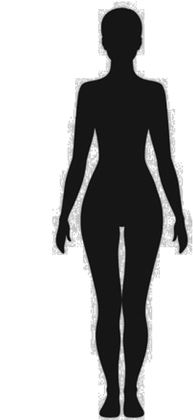
Module 1 Gender, sexual and reproductive health and rights and harm reduction
Portraits:
10 mins
Working in 2 groups
Use the cards to draw the portrait of the ‘good man’ and the portrait of the ’good woman’

Slide 4
Module 1 Gender, sexual and reproductive health and rights and harm reduction
Portraits Game of the roles of women and men:
15 mins
Individually
Who has the role for… ?
Move in front of the flipchart with the portrait of the good man or the good woman, according to the role described.

Slide 5
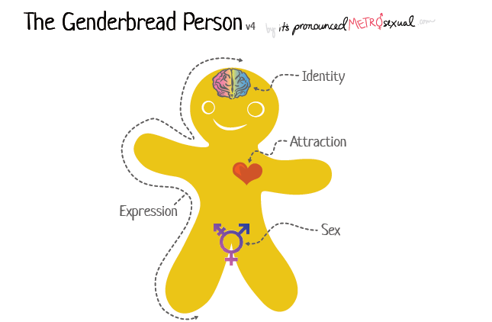
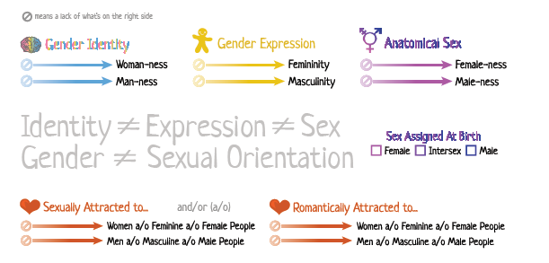
Module 1 Gender, sexual and reproductive health and rights and harm reduction
KEY DEFINITIONS

Slide 6
Module 1 Gender, sexual and reproductive health and rights and harm reduction
GENDER NORMS
Gender norms tend to assign women roles, usually associated with the private sphere, and men roles, usually associated with the public sphere.
For example:
Men are decision-makers
Men are masculine in appearance and action
Women are homemakers
Women are feminine in appearance and actions
These gender roles do not occur due to ‘natural’ differences between the sexes. Rather they are constructed, and come to seem natural because they are deeply embedded in our societies, through things such as culture and religion.
These norms vary from place to place and can change over time. They have a very powerful influence on us in many different ways

Slide 7
Module 1 Gender, sexual and reproductive health and rights and harm reduction
GENDER STEREOTYPES
Is a generalised view or preconception about the physical (including biological, emotional and cognitive) attributes or characteristics that are or should be possessed by women and men.
Transgender people and gender non-conforming people also experience harm from gender stereotypes, including serious discrimination that leads to social and economic marginalisation.
Gender norms and stereotypes have a profound affect on every aspect of life (such as our economic lives, our SRHR, our representation in decision-making, our domestic and community care roles).

Slide 8
Module 1 Gender, sexual and reproductive health and rights and harm reduction
CASE STUDIES:
20 mins
What are the types of norms and stereotypes faced by the woman who uses drugs in the case study?
Who expresses these norms or stereotypes (e.g. family members, community, health professionals)?
What are the specific harms and consequences of these gender stereotypes?
DISCUSSION:
Do you think you also hold your own stereotypes about women and gender non-conforming people who use drugs, or other marginalised women like sex workers, women living with HIV and transgender women?
Do you think these views might impact the range of services you provide and the way you provide them?

Slide 9
Module 1 Gender, sexual and reproductive health and rights and harm reduction
HARMS OF GENDER NORMS AND STREOTYPES
Gender stereotyping is a pervasive human rights violation
Harms of gender stereotypes :
Overburdening
Stigma
Discrimination
Low self-esteem and lack of confidence
Fear to access support
Violence (physical, emotional and sexual violence)
Lose child custody
Harmful gender norms and stereotypes are a root cause of gender-based violence and a rights violation

Slide 10
Module 1 Gender, sexual and reproductive health and rights and harm reduction
Gender equality
Gender equality means that men and women are sharing the same opportunities for full realisation of their human rights.
Gender inequality and gender-stereotyping prevent women and gender non-conforming people to access sexual and reproductive health services.
In particular, women and gender non-conforming people who use drug face compounded stigma, which is when multiple layers of stigma (e.g. based on gender, race/ethnicity, age, and other factors) overlap. For example, both women and men who use drugs may face stigma, but women who use drugs are often doubly stigmatised because drug use is seen as going against strongly held norms and expectations about being a woman – such as childcare and modest behaviour.
Women and gender non-conforming people who use drugs are at high risk of violence based on social stereotypes, backed by punitive laws.

Slide 11
Module 1 Gender, sexual and reproductive health and rights and harm reduction

Slide 12
Module 1 Gender, sexual and reproductive health and rights and harm reduction

Slide 13
Module 1 Gender, sexual and reproductive health and rights and harm reduction
Cross the line exercise:
15 mins
Move and cross the line on the left side if you agree, on the right side if you don’t agree

Slide 14
Module 1 Gender, sexual and reproductive health and rights and harm reduction
Sexual and reproductive rights
Sexual and reproductive rights are human rights that apply to sexual and reproductive health.
Sexual rights can include:
The ability to seek, receive and give information about sexuality
The right to be free from violence, pressure or coercion from a
partner, and to practice safer sex
The right to say ‘no’ and the right to a consensual marriage (above the legal age) and/or partnership. The choice of sexual partner(s).
The right to decide to be sexually active or not
The right to pursue a satisfying, safe and pleasurable sex life
Freedom to discover and develop one’s sexuality
Freedom from harmful practices, like genital mutilation and bride price

Slide 15
Module 1 Gender, sexual and reproductive health and rights and harm reduction
Sexual and reproductive rights
Reproductive rights are the rights of people to decide whether to give birth to a child or not, without discrimination, coercion or violence. They allow women to control their own reproduction.
Reproductive rights can include:
The choice to have children, and the freedom to decide if, when, and how many.
The right to correct information, choices and services related to reproductive health, including family planning, pregnancy and maternal care.
Freedom from forced sterilisation.

Slide 16
Module 1 Gender, sexual and reproductive health and rights and harm reduction
Sexual and reproductive rights
Reproductive rights are the rights of people to decide whether to give birth to a child or not, without discrimination, coercion or violence. They allow women to control their own reproduction.
Reproductive rights can include:
The choice to have children, and the freedom to decide if, when, and how many.
The right to correct information, choices and services related to reproductive health, including family planning, pregnancy and maternal care.
Freedom from forced sterilisation.

Slide 17
Module 1 Gender, sexual and reproductive health and rights and harm reduction
Continuum of care:
15 mins
Working in 3 groups
Pick and choose one sticky note
Discuss if this specific service is available only through SRH services facility or harm reduction programmes, or already integrated
Stick the note in the circle

Slide 18
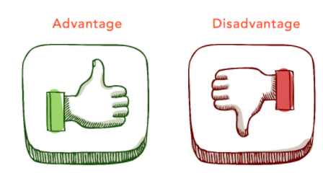
Module 1 Gender, sexual and reproductive health and rights and harm reduction
Group exercise:
15 mins
Working in 2 groups
List the advantages and disadvantages of linking and integrating SRHR services into harm reduction programmes
Report back:
5 mins

Slide 19
Module 1 Gender, sexual and reproductive health and rights and harm reduction
The continuum of care
It covers all the stages of human life (children/adolescent/adult/elder)
Ensures a continuum of adapted services at all stages of life
Ensures a continuum of adapted services in terms of accessibility (from services delivered at the community level, in primary health centers, at hospital).
Should be established to ensure links between SRHR and HIV prevention, care and treatment with all other harm reduction services.
* A continuum is something that is made up of a collection of stages or elements

Slide 20
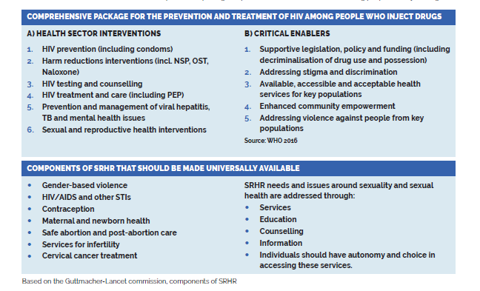
Module 1 Gender, sexual and reproductive health and rights and harm reduction

Slide 21
Module 1 Gender, sexual and reproductive health and rights and harm reduction
Challenges
It can be perceived to overburden services and facilities
It can be a drain on already-limited resources if not carefully planned
Advantages
Improve access and increase uptake
Provide better care
Reduce stigma
Increase efficiency

