Slide 1
Community-led human rights data for advocacy NOW: How marginalized communities respond to rights violations using evidence-based advocacy LESSONS FROM THE FIELD
SKILL BUILDING WORKSHOP
Chair:
Oratile Moseki - Frontline AIDS, United Kingdom
Facilitators:
Victoria Kalyniuk - Alliance for Public Health, Ukraine
Hape Peshoane - Gender Dynamix, South Africa
Amrita Sarkar - Alliance India, India

Slide 2
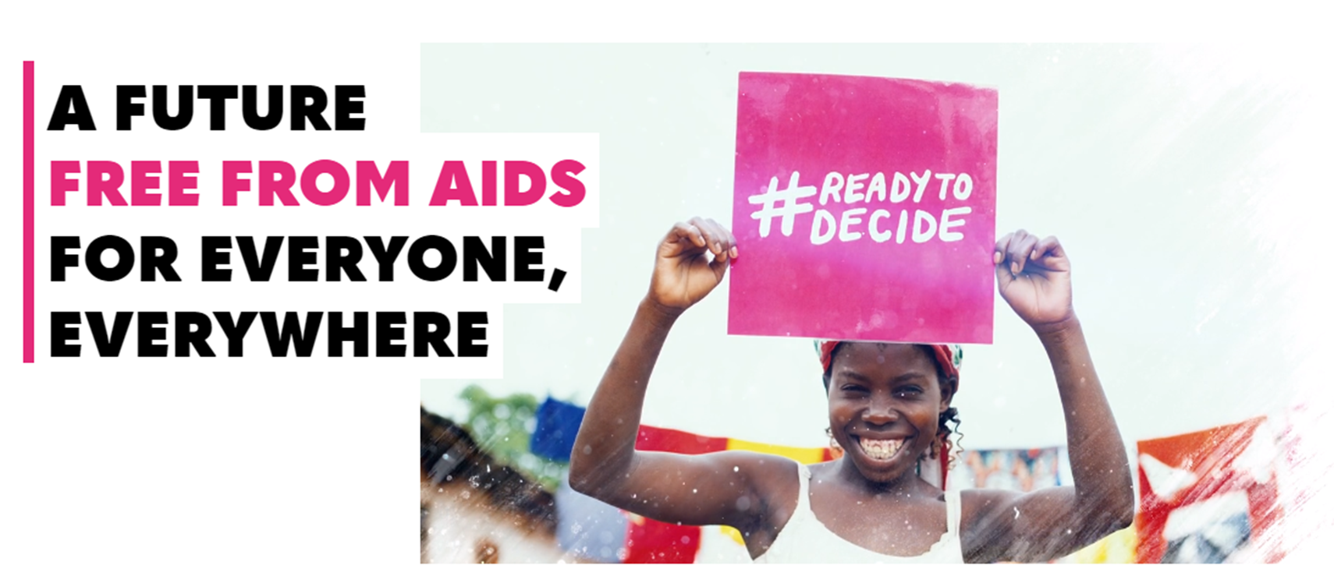
Introducing Frontline AIDS
Notes:
Oratile to present this slide: Frontline AIDS is a global partnership of over 60 civil society organisations in the countries most affected by the global AIDS epidemic working on the frontline of the HIV and AIDS response. We’ve been in existence for almost 30 years. We work to break down the social, political and legal barriers faced by marginalised people, investment in innovative community responses to HIV and local-to-global advocacy. Our offices are in the UK and South Africa.

Slide 3
Global policy acknowledgement that human rights are impeding development goals
Sustainable Development Goals: ‘Inequalities based on income, sex, age, disability, sexual orientation, race, class, ethnicity, religion and opportunity continue to persist across the world. Inequality threatens longterm social and economic development, harms poverty reduction and destroys people’s sense of fulfilment and self-worth.’
Political Declaration on HIV and AIDS: Ending Inequalities and getting on Track to end AIDS by 2030
Commit to urgent and transformative action to end the social, economic, racial and gender inequalities, restrictive and discriminatory laws, policies and practices, stigma and multiple and intersecting forms of discrimination, including based on HIV status, and human rights violations that perpetuate the global AIDS epidemic;
AIDS BY 2030
Notes:
Oratile to present this slide:
If we want to end AIDS, rights matter. But there is a massive gap in data.
The HIV epidemic will not end until human rights are respected and upheld. This is now a globally accepted fact.
Inequalities that underpin stigma, discrimination, violence and HIV-related criminalisation are a major reason why the 2020 global HIV targets were missed, according to UNAIDS. These inequalities are why millions of people living with HIV are still not on treatment and hundreds of thousands of people are dying of AIDS-related illness each year. That’s why UNAIDS’ 2021-2026 strategy calls on governments, development and financing partners, communities, global technical leaders and policymakers to identify and remove social and structural barriers to the HIV response. And it’s why the Global Fund’s latest strategy (2017-2022) calls for the same, highlighting how rights’ violations are undermining an effective response to HIV, tuberculosis (TB) and malaria.
As Frontline AIDS, we celebrate the global acknowledgement of the role that rights must play in ending AIDS. But there is a problem. General data on marginalised communities, the communities most affected by HIV, and on human rights barriers specifically, is critically insufficient. This lack of data means there is not enough evidence about the structural and systemic barriers that marginalised people, such as sex workers, people who use drugs, men who have sex with men and LGBT people (often referred to as key populations), experience when they try to access HIV-related services and support. We need this evidence to inform the changes that must take place to meet the global HIV targets that will end AIDS. Many of these targets rely on the removal of rights-related barriers experienced by marginalised people in accessing HIV services.
Without this data we cannot track the nature, extent and impact of human rights barriers on HIV-related public health outcomes. We are missing information with which to inform our HIV responses and cannot back up our advocacy with the evidence needed to demand duty bearers to act and be accountable. However, we know the data can’t do all the work – we need to know how to translate the data into evidence that can be used effectively to inform influencers that are willing to change, and demand change from those who don’t.
We need data on marginalised communities now.
Many countries collect data on the general population. Examples include the national census, population surveys, administrative and service provision data, and population projection data. Yet this data often lacks indicators that monitor the human rights of marginalised communities. Even in the public health sector where marginalised populations are disproportionately impacted by HIV and where it is known that social and structural barriers are impeding access to HIV-related services, data on rights-related barriers is still lacking.
The data gap
Even the most basic data on communities most affected by HIV is missing.
A review of evidence collected in 123 low- and middle-income countries between 2001 and 2017 found that:
75% do not have any HIV prevalence data for transgender women
50% do not have any HIV prevalence data for people who inject drugs
20% do not have any HIV prevalence data for men who have sex with men
20% do not have any HIV prevalence data for sex workers
40% do not monitor HIV prevalence trends for sex workers and men who have sex with men
Two-thirds do not have adequate HIV prevalence data to inform national or local HIV key population programmes
Community-led monitoring presents a powerful and critical way to fill in these data gaps, or at least to demonstrate the need for greater integration of marginalised population data into existing population-level data sources. CLM data sends a message to others that human rights violations against marginalised communities are unacceptable, are being documented and will be challenged. Ensuring marginalised communities play a pivotal role in the design, delivery and oversight of the HIV response, including community-led monitoring on progress, is now recognised as key to achieving the 2030 targets to end AIDS. Government commitment to community-led responses is showing itself, not only through policy change, but the integration of such interventions into national HIV plans and funding requests. One of the clearest examples of this is the Global Fund’s human rights-based programming. We strongly welcome these strategies and the bold pivot they have made to focus on the essential task of reducing inequalities to end AIDS.
Frontline AIDS’ Global Plan of Action for 2020-2025 shares this vision. In it, we commit to ‘convene community networks to document and respond to human rights violations to hold governments and the private sector to account’. Rights – Evidence – ACTion (REAct) is central to this work. It is a community-led human rights monitoring intervention that not only records human rights violations but also responds to them, bringing resolution for the person or people involved and holding perpetrators and duty bearers accountable for respecting, protecting and fulfilling the human rights of the people and communities most affected by HIV.
Rights – Evidence – ACTion (REAct), developed by the Frontline AIDS Partnership, is a community-led human rights monitoring and response programme implemented by civil society partners. It is used to:
Document human rights-related barriers to accessing HIV and health services experienced by marginalised communities
Respond to individual cases, so that the person experiencing these barriers receives support, in the form of direct services or by being referred to a network of service providers
Guide human rights programming through the use of real-time data
Advocate for improved programmes, policies and laws at national, regional and global level
Since it began in 2013, REAct has been implemented by 140 community-based organisations in 31 countries in Africa, the Middle East, central Asia and eastern Europe.
UNAIDS, (2021), End Inequalities. End AIDS. Global AIDS Strategy 2021–2026. Available at www.unaids.org/sites/default/files/media_asset/global-AIDS-strategy-2021-2026_en.pdf
Global Fund, (2021), The Global Fund Strategy 2017-2022, Investing to End Epidemics. Available at www.theglobalfund.org/media/2531/core_globalfundstrategy2017-2022_strategy_en.pdf
As this guide is about data, the term ‘population’ and ‘key population’ (meaning a population group most affected by HIV) are sometimes used. But it is important to note that people are affected by HIV because they are marginalised not because they are part of a certain population group.
Garcia, A. et al. (2020), ‘Availability and Quality of Surveillance and Survey Data on HIV Prevalence Among Sex Workers, Men Who Have Sex With Men, People Who Inject Drugs, and Transgender Women in Low- and Middle-Income Countries: Review of Available Data (2001-2017)’ in JMIR Public Health Surveillance, 6 (4), e21688, as cited in Zhao, J. / The Global Fund (17 December, 2020) ‘Data saves lives. To end HIV, we must improve key population data collection now’ [web article, accessed November 2021], available at www.theglobalfund.org/en/blog/2020-12-17-data-saves-lives-to-end-hiv-we-must-improve-key-population-data-collection-now.
Frontline AIDS (2019), Towards a Future Free from AIDS for Everyone, Everywhere: Global Plan of Action 2020-2025. Available at https://frontlineaids.org/wp-content/uploads/2019/11/FrontlineAIDS-GlobalActionPlan-ENGLISH.pdf.
Frontline AIDS (2021), Rights and REActions: results and lessons learned from REAct. Available at https://frontlineaids.org/wp-content/uploads/2021/09/Rights-and-REActions-results-and-lessons-from-REAct_Sep2021.pdf

Slide 4
What are the challenges faced?
Criminalisation and inadequate legal protection
Key populations lack awareness about their rights, and violations are often normalised
Key populations often unaware of mechanisms to report violations, or reluctance to do so for fear of reprisal
Multiple levels of discrimination are compounding barriers
Societal crises are compounding barriers for key populations (COVID-19, natural disasters, political instability including wars)
Community-led monitoring systems are under resourced
Crises response funding is limited
Not aware about the needful if complaints are not taken
Notes:
By: Victoria

Slide 5
Recommendations for governments
Invest in and scale up community-led monitoring and response systems as a key feature of HIV national plans, policies and budgets
Open spaces for civil society to report human rights data and use it to advance the health and rights of key populations
Repeal all punitive practices, regulations, policies and legislative provisions criminalising key and marginalised populations
Fulfil duties to respect, protect and promote rights in practice of key and marginalised populations
Notes:
To commit to investing in CLM systems as a key feature of their systems for health, expressed in HIV national response plans, policies and budgets
Open spaces for civil society organisations to report CLM data and welcome its consideration in all decision making relating to public health priority setting and the necessary reforms in policy and law to enable key and marginalised populations to access equitable health care and justice, including repeal of provisions of criminal law that impede public health outcomes.
Repeal all punitive practices, regulations, policies and legislative provisions criminalising key and marginalised populations underpinning the justification for social and systemic manifestations of stigma, discrimination and violence against such groups.
Ensure that all HIV prevention and treatment programmes are implemented with due respect and protection of the human rights of key and marginalised populations, including the establishment of harm reduction programming as a primary HIV prevention strategy for people who use drugs. Criminalisation and other punitive measures are not reasonably justifiable and cannot continue to stand in the way of efforts to end AIDS as a global public health threat.

Slide 6
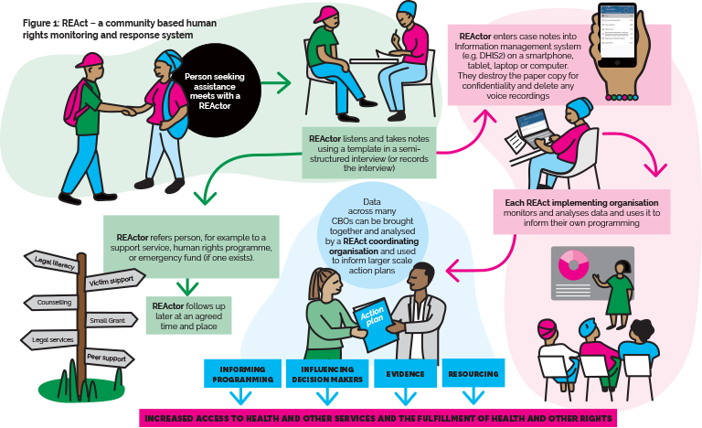
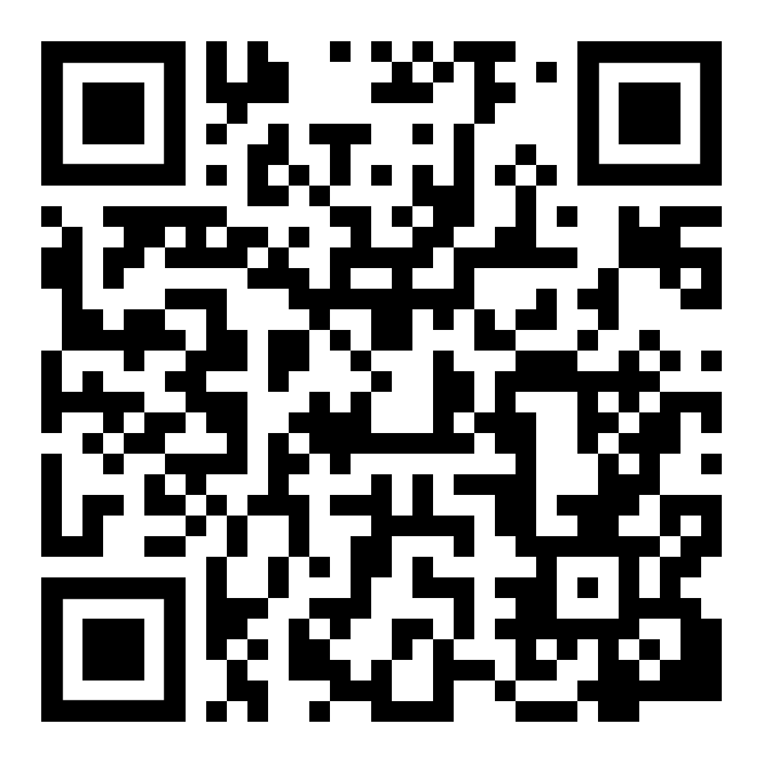
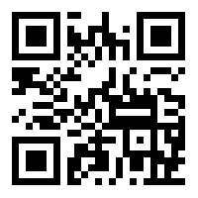
https://frontlineaids.org/our-work-includes/react/
https://react-aph.org/en/

Slide 7
Getting started: How to set up a community-led monitoring project
Be clear about your objectives: Be clear what you want to document and what for
Design your documentation template: informed by existing tools in use e.g. REAct
Take ethical & legal considerations into account: including ethics bodies, data regulation laws
Choose a safe and friendly information documentation system/tool – and ensure you have good data management skills
Design and implement a security plan: of data, clients, documenters, organisations
Involve your communities: in all aspects from design to evaluation
Build ownership & preparedness of key stakeholders: Legal aid, health practitioners, educational, religious, policy makers, other civil society actors
Seek advice and technical expertise from community experts: local and otherwise
Train your documenters and ensure they have the knowledge and skills they need
Build a referral system and a system for responding to emergencies
Notes:
https://pubmed.ncbi.nlm.nih.gov/29098202/

Slide 8
Community-led Documentation of Human Right Violations: Be clear about your objectives: Be clear what you want to document and what for
What are your goals?
Set your goals with the involvement of the communities you serve
How do you intend to use your data must be very clear – programmes, policy

Slide 9
Important tools you will need when documenting:
1. Interview guide for community documenters – ensuring systematic documentation and ensuring ethical standards around consent, confidentiality are maintained
2. Consent forms – accompanying the process of establishing informed consent before any documentation happen
3. Documentation template:
Indicator ensuring client confidentiality (e.g. Unique Identifier Codes)
Ensuring clients’ informed consent is established
Data indicators that are clear and understandable to documenters, in the language they speak
Alignment to national policy indicator
4. Information sheet for clients to take home: accompanying a thorough pre-documentation discussion with your client to ensure they understand the risks and benefits of participating
5. Referral note for clients referred for services
Notes:
QR Code link to REAct website

Slide 10
Features of your information management system DHIS2
Security
& data sharing control
Accessibility
Case management
System & data management features
Affordability
User friendliness
Sustainability
Analysis and reporting
Notes:
Security and data sharing control:
Built in encryption
Two-factor authentication, pin protected
Cloud-based system
Access:
Can be used with basic training
Offline features
Mobile & computer
Case management:
Can store and analyse multiple surveys
Can track cases anonymously
Can track follow up actions.
System & data management features:
Free upgrades
Interoperable outputs
Has required/optional data field settings.
Can set different roles with different access and functionality.
Has data validation rules.
Affordability:
Hosting options: choose own host or contribute % to Frontline AIDS instance of Wanda
Free open source software
User friendliness:
Customisable forms in different languages and scripts and translation
User friendly interface
attachments
Visual branding
Sustainability:
Well established and long running system with very wide adoption globally
Infinitely scalable.
No licenses required
Analysis and reporting:
Pre-set & custom reports
Basic and sophisticated analyses.
Has data visualisation.

Slide 11
What are you collecting? What is data?
Quantitative indicator | Qualitative indicator
Number of people reporting abuse | What are the profiles of the people reporting the cases?
Number of perpetrators | What are the profiles of the perpetrators committing the abuses?
Number of people who received a referral for a service | What kinds of services are people requesting?
Notes:
Data is a collection of facts, such as numbers, words, measurements, observations or just descriptions of things that, when taken together and analysed, describe the characteristics of something. Data is raw, unprocessed facts. Data can be quantitative, or qualitative.
Quantitative data expresses information that can be counted. It is used to answer questions such as ‘How many?’, ‘How often?’, ‘How much? and ‘What proportion?’ It is often collected using surveys, case records and administrative data. An example of quantitative data is the number of human rights violations reported within a month.
Qualitative data describes information or the quality of something, and usually focuses on individuals’ experiences or contextual factors (human stories). It is used to answer questions such as ‘Why?’, ‘What for? and ‘How?’ It is often collected through observations, interviews, focus groups and case studies. An example of qualitative data is descriptions by sex workers of police harassment.
Quantitative and qualitative data work hand-in-hand. Together they can tell you how much of a thing is occurring, and the quality of that thing. For instance, the number of people (quantitative) who are experiencing discrimination (qualitative).
Indicators are the building blocks, or measures, of data. Indicators are often used to assess changes or track progress against goals and targets. They can be qualitative or quantitative and can be combined with other indicators to provide a more complete picture of the overarching goal.

Slide 12
Human rights indicators: fact-based and judgement-based
Examples of objective indicators (Observable fact) | Examples of subjective indicators (Judgment call)
Age of client | Reason for not accessing a service
Where the incident took place | Client believes they were discriminated against (Yes/no)
Type of perpetrator | Did client consider the conduct to be a physical, mental or sexual assault?
Marginalised community the client identifies as belonging to | Were rights breached?
Police hit client (Yes/no) | Client was discriminated against (Yes/no)
Case was reported (Yes/no)
Notes:
Human rights indicators are often categorised as either fact-based (objective) or judgement-based (subjective). Fact-based indicators are ones that can be directly observed or verified. Indicators that require you to give an opinion, express a perception, make a judgment or describe a feeling are subjective indicators.
The difference between the two categories is important because subjective indicators are often considered to be debatable, whereas objective indicators are generally viewed as observable facts. Human rights data is particularly interesting because the indicators can be expressed as both objective and subjective. It is important that the formulation of our indicators gives us the best opportunity to create the strongest evidence that we can. We can make our subjective indicators strong by documenting observable facts related to them, which back up the judgment made in the subjective indicator.
For example, if someone is hit by a police officer, the physical act of hitting is a fact that can be observed and cannot be debated, so it is an objective indicator. But there is also a way to document this fact using a subjective indicator – the person who has been hit describes the hitting as a breach of their safety and security, whereas the police officer may say that they were well within their rights to hit the person.

Slide 13
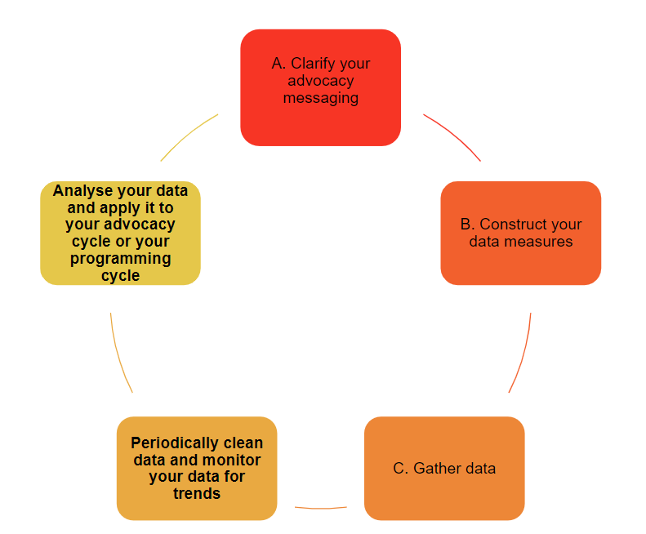
Notes:
The illustration of the data management cycle below shows the process in which data is gathered then translated into effective evidence for advocacy.

Slide 14
Safety & Security, Ethics, and Law
Ensure maintain ethical standards of practice, including those required by ethics bodies
Comply with national data regulation laws and standards of practice
Design and implement a security plan to protect data, clients, documenters, your organisation:
Conduct regular security assessments (of system, and people involved) and implement recommendations
Security protocols – everyone knows what to do when a security crises happens
Educate documenters and communities about how to stay safe

Slide 15
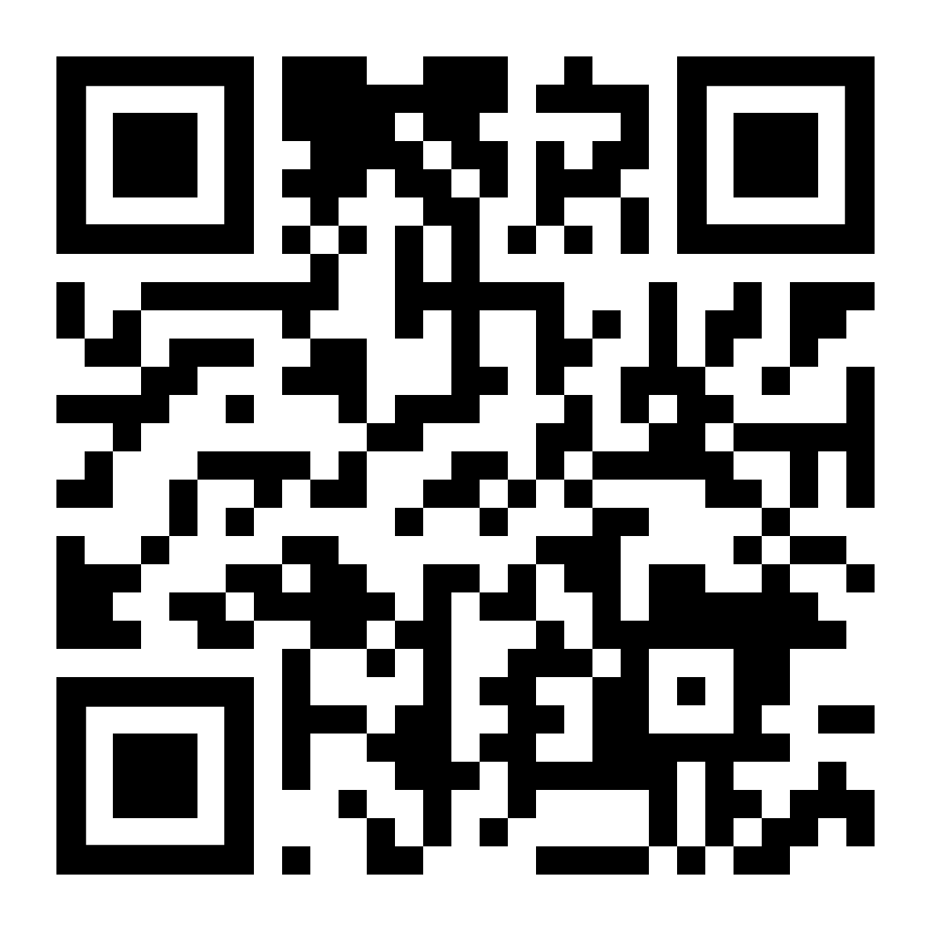
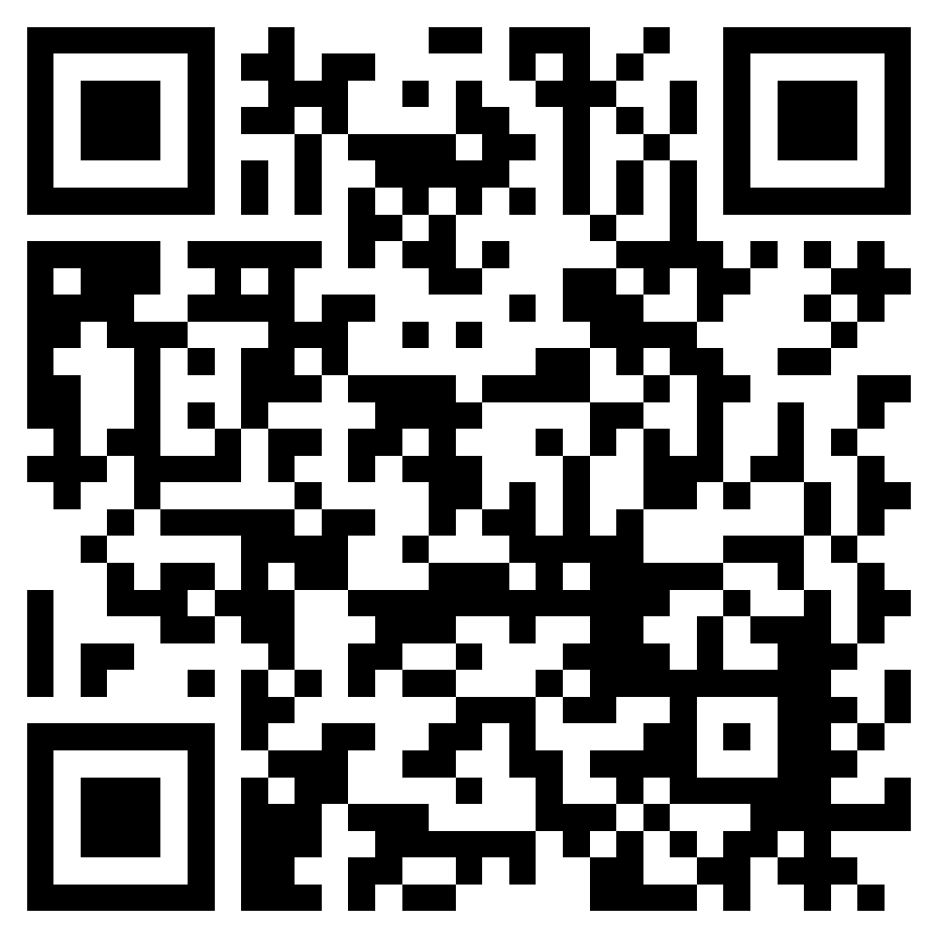
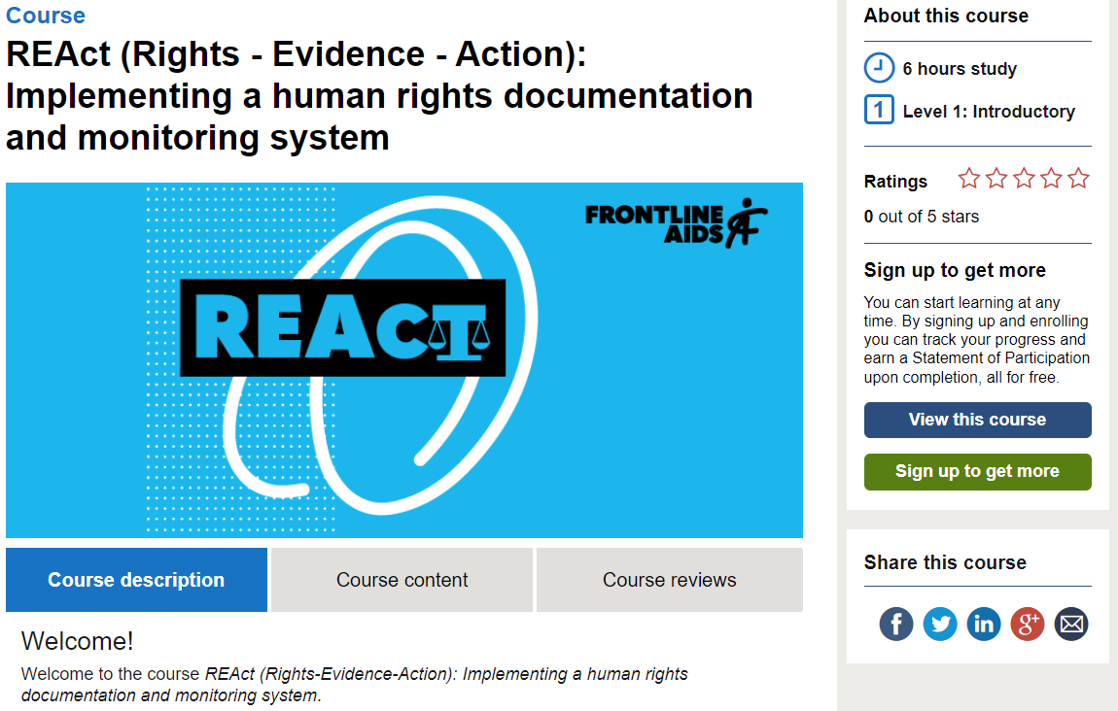
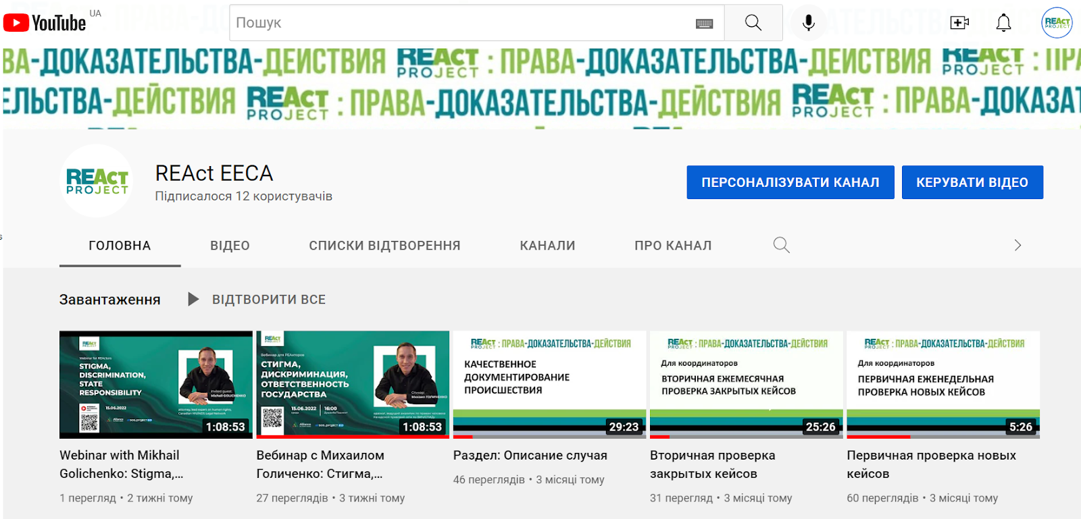
Existing training tools, courses and guidance
Drug Decriminalisation Course:
available in English, French, Russian, Arabic
https://idpc.healthefoundation.eu/
REAct EECA youtube channel

Slide 16
Key considerations for responses
Individual responses: Respond to the needs of your client immediately, and with their direction
Make sure your referral system is functional & meet communities’ needs
Emergency responses

Slide 17
Providing an immediate individual response to client
Medical referrals & linkages
Enabling specialised support and care: e.g. Gender affirming Legal & Medical Interventions
Enabling access to legal aid support & services
Livelihood support
Notes:
Medical referrals & linkages - HIV/AIDS/STI and other medical tests and surgical specialists (obstetrician, gynecologist, psychiatrist, etc.)
Enabling specialised support and care: e.g. Gender affirming Legal & Medical Interventions: Helping clients get official/legal status of preferred gender identity; Facilitating access to hormone replacement therapy, genital reconstruction, breast reconstruction, etc
Enabling access to legal aid support & services: paralegal support, lawyers
Tele counselling and hotline support
Livelihood support- linking with other public services

Slide 18
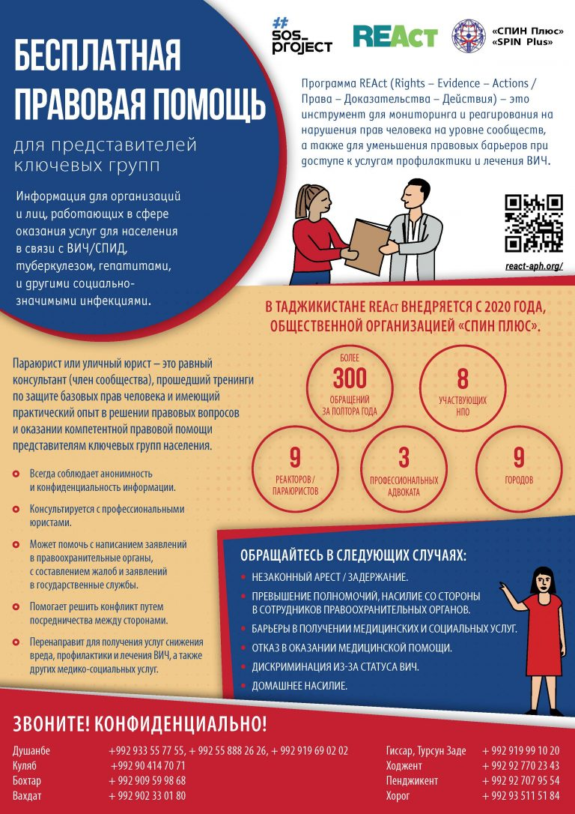
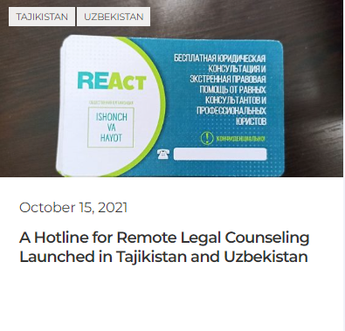
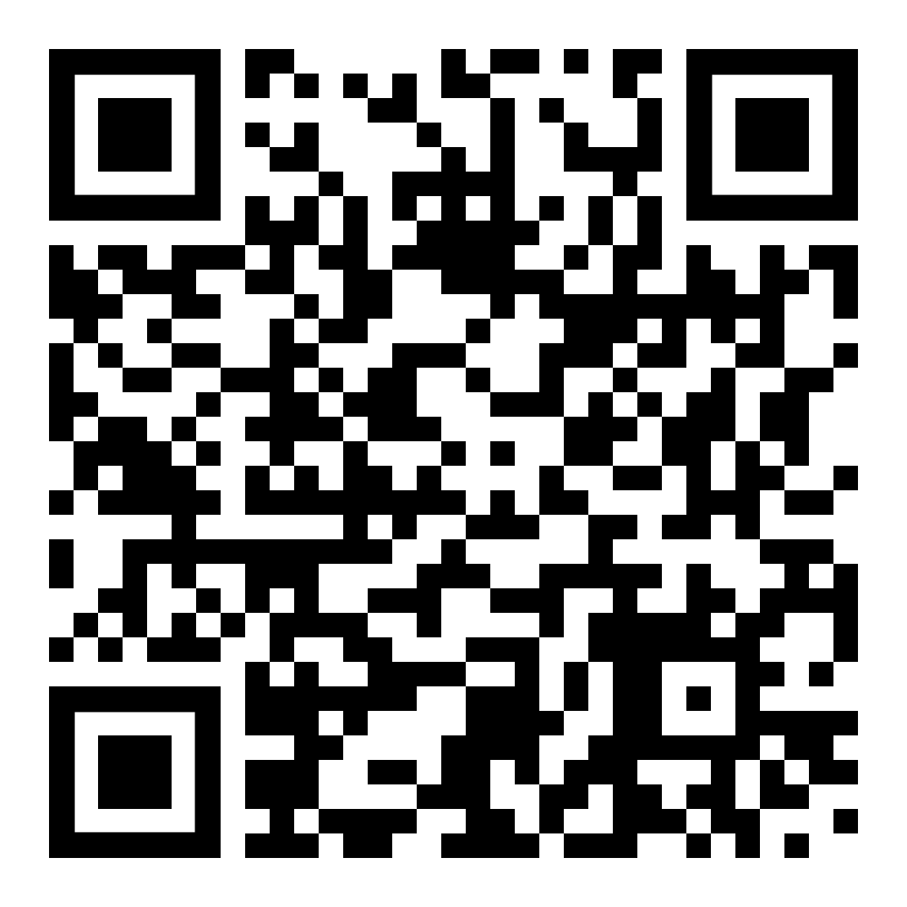
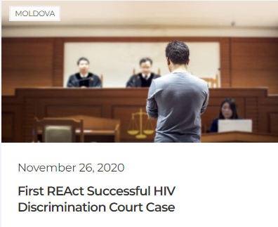
Providing an immediate individual response to client
Tele counselling and hotline support
24/7 distant consulting in emergency cases (detentions, violence)
Legal and health literacy training
Crisis response funding
Notes:
Medical referrals & linkages - HIV/AIDS/STI and other medical tests and surgical specialists (obstetrician, gynecologist, psychiatrist, etc.)
Enabling specialised support and care: e.g. Gender affirming Legal & Medical Interventions: Helping clients get official/legal status of preferred gender identity; Facilitating access to hormone replacement therapy, genital reconstruction, breast reconstruction, etc
Enabling access to legal aid support & services: paralegal support, lawyers
Tele counselling and hotline support
Livelihood support- linking with other public services

Slide 19
Take a few minutes to do the self-assessment before we continue on to advocacy…

Slide 20
Skills: How to turn your data into evidence for advocacy
Data findings | Evidence | Advocacy message supported
In year one, 2,000 sex workers reported cases of abuse. In year two, 4,000 sex workers reported cases of abuse. The number of cases has doubled in one year. | There is a significant increase in reports of human rights abuses amongst sex workers. Or, There is a greater uptake of reporting by sex workers. | Sex workers’ rights need to be protected and we need more support to deal with the human rights abuses they face.
Notes:
Evidence is the meaning that is generated when raw data is interpreted. When we interpret the data and draw conclusions it becomes evidence, which we can use to justify or support a point of view, an argument or an opinion. Given that meaning is subjective, it is possible that the same data source can be used to establish different conclusions, resulting in different evidence. As activists, it is a powerful thing if we can apply our evidence to strengthen our advocacy arguments.
Dammann, O. et al. (2019), ‘Data, Information, Evidence, and Knowledge: A Proposal for Health Informatics and Data Science’, Online Journal of Public Health Informatics, 10 (3), e224. https://doi.org/10.5210/ojphi.v10i3.9631

Slide 21
7 Safeguarding principles when using data for advocacy purposes
Fair, lawful and transparent: the individual should be clearly informed and aware of how their data is going to be used or shared.
Purpose limitation: the proposed use of the data must be clearly defined and explained to the individuals sharing their data, and its use should be limited to this purpose.
Minimisation: only data that is necessary and relevant to the stated purpose should be used.
Accuracy: personal data should be accurate, complete, up-to-date, and relevant for the purposes it is meant for.
Storage limitation: Personal data should only be kept for the period of time that the data is required for to address the purpose for which it was originally collected and stored.
Integrity and confidentiality: Personal data should be protected against risks, such as loss, destruction or damage or unlawful or unauthorised access, use or disclosure.
Accountability: This means that the people who are collecting and using personal data have a responsibility to ensure that all data protection principles are followed.
Privacy International (2018), A Guide for Policy Engagement on Data Protection: The Keys to Data Protection.
Notes:
Often, the information you will be collecting will be of a sensitive or personal nature, so care should be taken not to further increase someone’s vulnerability when collecting and using data. By acknowledging the layers of considerable power imbalances and inequality at play, those collecting data should ensure that people who share their experiences understand and give fully informed consent for their data to be used. The principles of responsible data use, data protection, and ethical and legal considerations should also be employed.
There are seven data protection principles that should be taken into consideration:
Fair, lawful and transparent: the individual should be clearly informed and aware of how their data is going to be used or shared. Only data with informed and voluntary consent should be used or shared.
Purpose limitation: the proposed use of the data must be clearly defined and explained to the individuals sharing their data, and its use should be limited to this purpose. If there is a need to use this data for other purposes, the person should be informed and their consent for this new use should be obtained.
Minimisation: only data that is necessary and relevant to the stated purpose should be used. Anonymity should be ensured at the time of transcription to remove any individual identifiers. At the same time, we should avoid anonymisation that may distort data or make it unusable, unreliable or misleading.
Accuracy: personal data should be accurate, complete, up-to-date, and relevant for the purposes it is meant for. Only use images of an individual(s) to illustrate an issue that is related to them. Care must be taken to ensure that you do not leave out relevant data as this can lead to inaccurate conclusions being drawn. The data used should accurately represent contributors, their stories and their situations, including providing context to avoid stereotyping. Avoid biased representation of a population group; be objective in choosing the stories to tell.
Storage limitation: Personal data should only be kept for the period of time that the data is required for to address the purpose for which it was originally collected and stored. After this, data should be deleted.
Integrity and confidentiality: Personal data should be protected against risks, such as loss, destruction or damage or unlawful or unauthorised access, use or disclosure. The principle of do no harm must be followed, which means respecting, protecting and promoting people’s human rights. Use of someone’s data should not make them vulnerable or put them at risk of negative consequences, such as reprisals, violence or stigmatisation.
Accountability: This means that the people who are collecting and using personal data have a responsibility to ensure that all data protection principles are followed. This means considering who will see the data that is shared, and any negative repercussions for sharing. (For example, if a case of police abuse is reported to the police, does this put the person who was abused at risk of reprisals and further police violence, if the police are able to cross reference details in the data to identify the person?) Additional care must be taken when gathering content from children and adolescents, with their identity protected so that they are never traceable by anyone who intends to cause them harm. For communities or individuals whose identities are criminalised or otherwise stigmatised, strategies should be devised to present facts or stories while protecting privacy and confidentiality.
Privacy International (2018), A Guide for Policy Engagement on Data Protection: The Keys to Data Protection. Available at https://privacyinternational.org/sites/default/files/2018-09/Data%20Protection%20COMPLETE.pdf

Slide 22
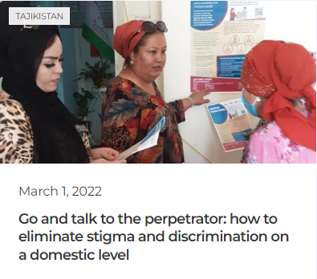
Local advocacy: Change happens at the community level
Go and talk to perpetrator - if it is safe to do so
Empower communities to know their rights and know how to access justice!
Influence local leaders to champion rights
Sensitise and train health care providers, police, legal aid providers on how to respect, protect rights of key population and other marginalised groups

Slide 23
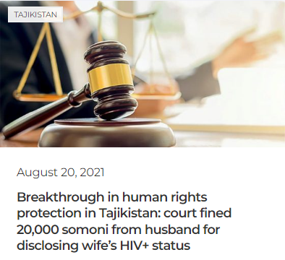
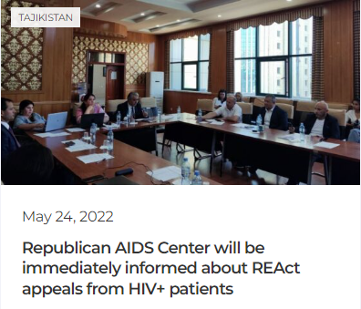
Lessons from the field: National advocacy
Advocacy can be aggressive and soft. Consider which is more appropriate for your country and situation.

Slide 24
Global Human Rights Advocacy: what are the platforms and processes of influence?
Examples:
Universal Periodic Review (UPR) processes - proposing recommendations
Obtain Observer Status with Human rights bodies
Hold cross regional dialogues and cross movement dialogues
Contribute to human rights treaties general comments
Subscribe to Global Networks and Forums
Data (REAct) used to advocate for the renewal of the UN SOGI independent expert mandate
Consolidate evidence-based reports
Used for litigation advocacy

Slide 25
Example from the field: Gender Dynamix
Data (REAct) used to advocate for the renewal of the UN SOGI independent expert mandate
Consolidate evidence-based reports for human rights violation reporting
Used for litigation advocacy

Slide 26
Global Advocacy - Lessons from the field:
The Frontline AIDS partnership to prevent, challenge and respond to violence, harmful social and gender norms and discrimination against gender diverse people
Step 1: Partners endorse concept note
Step 2: Partners convene to share work on GBV against transgender people, update each other on priorities and discuss/agree coordinated engagement with Generation Equality Forum Action Coalitions
Step 3: Partners collate and review data and design protocol for additional data gathering
Step 4: Partners develop commonly shared recommendations to help progress ending violence against transgender and gender non-conforming people in the context of HIV
Link to trusted access platforms framework for HIV programming
Feed into Generation Equality Forum Action Coalition on GBV
Frame in a language big donors (PEPFAR, CDC etc.) will understand the kind of thing their partners need
Include Frontline good practice guide on gender transformative HIV programming
Step 5: roll out framework to other stakeholders and the community to continue data gathering, monitoring and reporting
Partners involved:
India HIV/AIDS Alliance
Redlactrans
Southern Africa Trans Forum
Gender Dynamix (South Africa)
Trans Equality Uganda
Mena Rosa

Slide 27
Questions?

