Slide 1

Rights
Evidence
ACTion
TRAINING OF REACTORS
Notes:
Materials
Flip chart paper, markers, tap, agenda
Introduce yourself and the team and welcome participants. Explain or recap any necessary logistical issues

Slide 2
T2.1
WELCOME AND INTRODUCTIONS
Notes:
Introduce yourself and the team and welcome participants.
Ensure all participants have a copy of the agenda and Unit R from the REAct guide – check if there are any questions about the agenda
If applicable, introduce a local keynote speaker to give introductory remarks
Lead an activity to help participants introduce themselves
Ask participants to pair up with someone they don’t know and give the pairs five minutes to get to know each other. Bring the group back together and ask each person to briefly introduce their partner
Write down group expectations on a flip chart for all to see

Slide 3

Notes:
Agree some ground rules with the group. Explain that for the workshop to be enjoyable and successful for everyone, and the objectives to be achieved, it helps to have some group norms. Have the group suggest some they may like to include such as:
Active participation
Listening to one another
Punctuality
Cell phones on silent
Record these on a flip chart and tape up where it can be easily seen

Slide 4
T2.2
INTRODUCTION TO REACT
Welcome and Introduction to REAct
Under-standing our context
Human rights principles and responses
Collecting evidence
Managing information
Next steps

Slide 5

“REAct is a key process that both documents human rights violations to contribute to the growing evidence base around the experience of LGBT+ and sex worker communities; as well as providing a roadmap for referral processes and advocacy and programme planning and design”.
REAct coordinator, KP REACH, Positive Vibes Trust.
Notes:
Rights – Evidence – ACTion (REAct), developed by Frontline AIDS, is a human rights monitoring and response system that records and manages information at the community level. REAct documents human rights-related barriers in accessing HIV and health services. Through REAct, organisations can record data about human rights violations experienced by individuals, provide and refer them to health, legal and other public services and thereafter use the
data gathered to inform quality human rights-based HIV programming, policy and advocacy at national, regional and global levels.
Respond to individual crises or emergencies - the system enables implementers to identify and prioritise crisis situations and rapidly mobilise resources to avert or respond to specific individual crises and/or emergencies; for example, violence, and eviction or discrimination in the workplace.
Provide or refer to rights-based programmes and interventions - Rights-based programmes are increasingly incorporated into the package of HIV interventions, and information collected through REAct helps Implementing Organisations to identify the right combination of human rights interventions.
Build a body of evidence for advocacy - REAct collects information on rights-related barriers in accessing services for which the state has direct responsibility. The system will generate quantitative and qualitative evidence on the impact of human rights violations on the effectiveness of the HIV response. This body of evidence is essential when engaging with and making state and non-state actors accountable.
Although this guide focuses on REAct in the context of HIV, REAct can be adapted to document and respond to human rights related barriers to accessing HIV-related health services. These include tuberculosis (TB), hepatitis C, sexual reproductive health services, harm reduction interventions in the case of people who use drugs, and others.
Why was REAct needed, and how was it developed?
REAct was developed with, and for, CBOs to provide them with an easy and systematic way to support individuals who were experiencing human rights violations impeding their access to health and other services. It also responded to a need for data that organisations could use to advocate for sustainable, rights-compliant health services. At the time when REAct was developed, CBOs were grappling with the on-going reality that community members, particularly those from marginalised groups, were experiencing human rights violations as a result of stigma, discrimination, violence and criminalisation, which was making it difficult for them to access HIV- related and other health services

Slide 6


What we hope to achieve
Notes:
By the end of this training, participants should be able to…

Slide 7
By the end of this training, participants should be able to:
• Understand (knowledge)
• Demonstrate (skills)
• Develop the right attitude
Notes:
Understand (knowledge)
Understand how REAct contributes to HIV responses in your country and your role in it.
Understand Human Rights in the context of HIV and access to health services.
Understand REAct information management system, Wanda
Understand data analysis
Demonstrate (skills)
Demonstrate documenting human rights challenges that impeded access to services
Demonstrate navigation of Wanda, including data entry and data analysis
Demonstrate data security
Demonstrate how to conduct interviews
Attitudes
To develop respect for the rights of the individual
Develop non-judgement
Develop compassion

Slide 8
REAct: Past, present and future
Past
Developed by Frontline AIDs
Field tested in Uganda, Myanmar and Bangladesh in 2014
Since then it has set up in 22 countries across the world
Present
A new robust IMS system has been developed
Standardised and unique indicators developed
Focus on client follow up
REActors can make programme intervention-level recommendations
Future
Opportunity to transition REAct from small scale to large scale, from community and district levels to national programmes
Notes:
Since its inception, REAct has grown in leaps and bounds. It has been used by individual CBOs, as well as within regional programmes such as KP REACH where it was rolled out across nine countries with CBOs and non-governmental organisations (NGOs) working across a wide spectrum of marginalised groups. In 2018, the information management system on which REAct was originally based – Martus – was phased out.
Frontline AIDS took this opportunity to take stock of lessons learnt from implementers to date, and to find ways to improve and strengthen REAct based on feedback from the ground. This resulted in five key changes:
Frontline AIDS adopted a new, robust information management system (IMS) for REAct
We explored ways to standardise the indicators used to monitor human rights violations, whilst also keeping options open for REAct implementers to tailor indicators
Our system not only facilitates referrals so that clients can access available services, but it also enables REAct implementers
to follow up with clients
Recommendations for human rights policy and programming can be made in each individual case
Opportunity to transition REAct from small scale to large scale

Slide 9
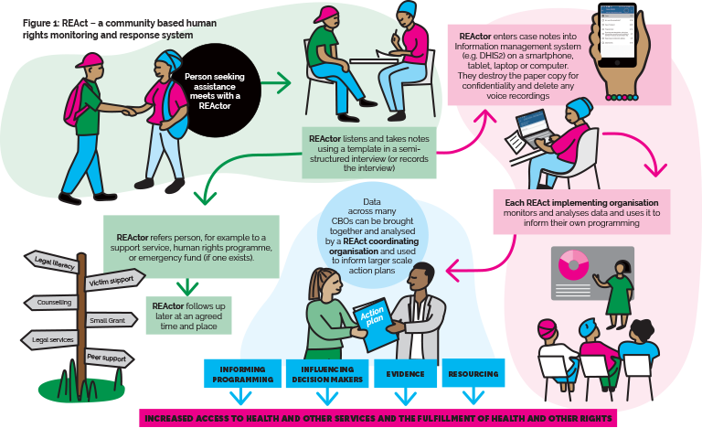
Notes:
Facilitator notes:
This schematic illustrates the REAct programme in a nutshell, from REActor to how the evidence can be used to inform better programming and for advocacy.
A beneficiary who has experienced a human rights violation meets with a REActors – the person who documents and responds to the beneficiary’s concern. The primary objective is first to help that individual by providing a direct services, facilitating a referral to other services whether medical or legal or otherwise, or educating that person on their health and/or their rights. The case leads to the facilitation of follow up, ensuring that available services referred to are accessed.
To meet the secondary objective of evidence gathering and use for other purposes beyond the individual’s immediate need, the REActor also documents the beneficiary's, disaggregating it by the kind of human rights violation, the perpetrator involved (state or non-state, family etc), usually at a later stage. This data analyses where gaps in services may exist, and analyses what kinds of programmatic needs may also be lacking, such as legal literacy training. Dashboards of data available in real time can be created that analyse the data, providing a holistic overview of the state of affairs. This collated and analysed data can then be shared without identifying individual cases themselves, to improve programmes, services or serve to advocate for structural changes.

Slide 10
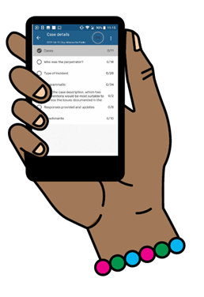

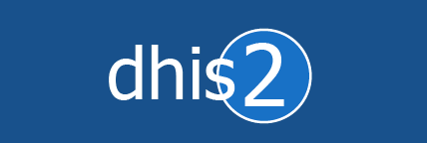
Which information management system does REact use, and why?
Notes:
REAct relies on a suitable information management system (IMS), like DHIS2, which FRONTLINE AIDS recommends for use. DHIS2 is an IMS that enables organisations to track and document individuals’ experiences of human rights abuses and violations. DHIS2 is a web-based open source software platform that enables the collection, management and analysis of data.
Frontline AIDS’ own customised version of DHIS2 is called ‘Wanda’.
Wanda can be accessed using a normal computer or laptop, as well as through an app using an Android mobile phone or tablet. It can be used both online and offline.
It is used by ministries of health in countries around the world, and also by organisations such as Marie Stopes International (MSI), the President’s Emergency Plan for AIDS Relief (PEPFAR), Population Services International (PSI) and the International Planned Parenthood Federation (IPPF).
The use of Wanda is optional, as you may already have an alternative monitoring and data management system.
Why Wanda?
Evidence provided in real-time is useful in making timely strategic decisions and planning. Continuous interrogation of human rights data is critical to inform human rights programming and advocacy plans. Wanda will provide real-time evidence for making timely and informed decisions.
Wanda will provide central storage for all evidence of human rights abuses and violations (obtained from routine monitoring), as well as tracking progress against Global Fund human rights M&E indicators.
Wanda will make it relatively quick and easy to aggregate and compare the quantitative and qualitative data submitted by partners. Whilst qualitative data can never be automatically aggregated, Wanda can help bring together and produce different views of the data to aid analysis.
Wanda is an online monitoring and reporting system that has been developed using DHIS2 (https://www.dhis2.org/inaction). DHIS2 is an open source software platform enabling governments and organizations to collect, manage and analyse data in the health domain and beyond. DHIS2 is being used by ministries of health in countries around the world and by organisations such as MSI, PEPFAR, PSI and IPPF.
Wanda can be accessed using your normal computer/laptop as well as Android mobile phones or a tablets. It can be used both online and offline.
The template consists of the following sections:
• Traceable information, including details around client consent
• Case details (multiple allowed)
• Type of incident – documents the kind of human rights violation/s
• Perpetrators – who the perpetrators are of the violation
• Responsibility of the state – identifies what the state’s duty is to the client inthis case, and whether this duty has been adequately performed.
• Information about what responses the client has already engaged in to resolve the issue prior to them seeking help from the REActor, and what additional help REAct has provided
• Policy recommendations
• Response provided, referrals made and follow up actions taken by the REActor toassess uptake of services.

Slide 11



Who benefits from REAct?
For policy makers and programming actors locally and globally
Clients – our first priority
Implementing organisations
Notes:
For individual clients, REAct:
helps identify and document emergency responses and support.
ensures a confidential service.
facilitates a continuum of support and follow- up for cases and individuals.
provides evidence to improve access to HIV and other health services.
improves understanding and realisation of human rights.
For implementing organisations, REAct:
enables better identification of appropriate human rights responses for each community.
enables better understanding of the human rights situation in each context.
builds a body of better evidence to demonstrate a community’s human rights needs and how best to respond to them.
enables better evaluation of the effectiveness and impact of the responses provided.
strengthens referral systems.
serves as an outreach tool for increasing access to and uptake of HIV and related health services and referrals.
ensures safe and confidential gathering of sensitive data.
identifies priority funding needs (when a Small Grant Scheme is attached) for:
emergency individual responses
human rights programmes
advocacy.
can be run without a grant by collecting data and making referrals. This evidence can then be presented to donors to secure funding.
For policy makers and programming actors locally and globally, REAct:
gathers robust data and a body of evidence on human rights violations and barriers to accessing HIV and related health services for specific population groups.
records compatible and comparable data that can be analysed across countries and client groups.
provides robust evidence for the link between human rights violations and vulnerability to HIV.
provides robust evidence for improving access to HIV and other health services.

Slide 12
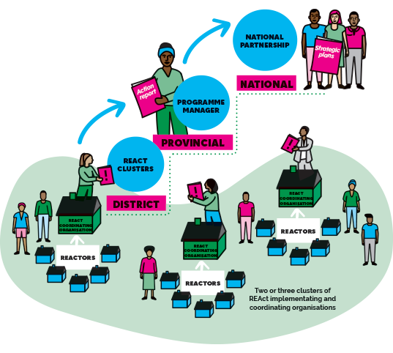
Opportunity to transition REAct
from small scale to large scale
Notes:
Opportunity to transition REAct from small scale to large scale:
Originally REAct was being used by small CBOs across many countries, but not at scale. The new REAct programme model seeks to strengthen programming partnerships between governments and civil society to better document and respond to human rights violations. At the time of publication, several national-level government institutions were showing an interest in implementing REAct at a large scale. Frontline AIDS is exploring the programming implications with a view to carrying out a pilot programme that would expand from small and medium scale (i.e. community- and district-levels) and then incrementally scale up to a national programme.

Slide 13
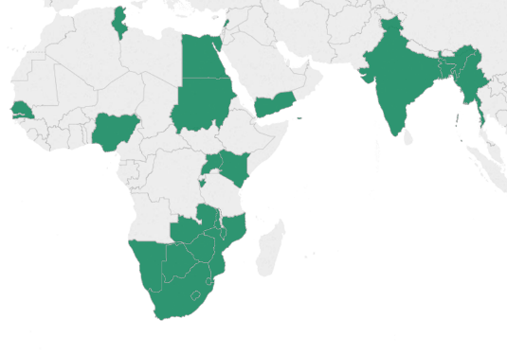
Where has REAct been rolled out?
Set up in in 22 countries (Bangladesh, Botswana, Burundi, Egypt, India, Kenya, Lebanon, Lesotho, Malawi, Mozambique, Myanmar, Namibia, Nigeria, Senegal, South Africa, Sudan, Swaziland, Tunisia, Uganda, Yemen, Zambia, Zimbabwe)
Operational in 13 (Botswana, Burundi, India, Lebanon, Lesotho, Malawi, Myanmar, Namibia, South Africa, Swaziland, Tunisia, Uganda, Zimbabwe)

Slide 14

Research
Alliance India – Wajood
2,778 transgender and hijras were registered with Wajood programme and provided sexual health and rights services (November 2015 – October 2016). Among those registered, 2,047 transgender and hijras have reported violence faced in last six months at the time of registration. There are 96 cases have been reported as human rights violation cases
Analysed 16 cases studies of gender-based discrimination and violence
Gain a better understanding of:
  Client profiles
  Types of violent incidents
  Perpetrators
  Where violence takes place
  Responses
Notes:
Research for Wajood: The project used REAct software (community-based human rights monitoring and response system) to monitor the violence cases reporting and responses. It is used for crisis reporting under Wajood with a specific and customised format and enables community based organizations to document violence reporting and identify potential barriers on accessing Health and Human Rights services.
2,778 Transgender and Hijras were registered with Wajood program and provided sexual health and rights services (November 2015 – October 2016). Among those registered, 2047 Transgender and Hijras have reported Violence faced in last six months at the time of registration. There are 96 cases have been reported as human rights violation cases of which 89 cases have been responded and 7 case are yet to be attended and are pending to be solved.
Reviewed the cases as entered by the partners in MARTUS for the period of three months (March to May 2016), 16 unique case studies were analysed in-depth to understand profile of the clients who faced violence/crisis and the kinds of violence.

Slide 15
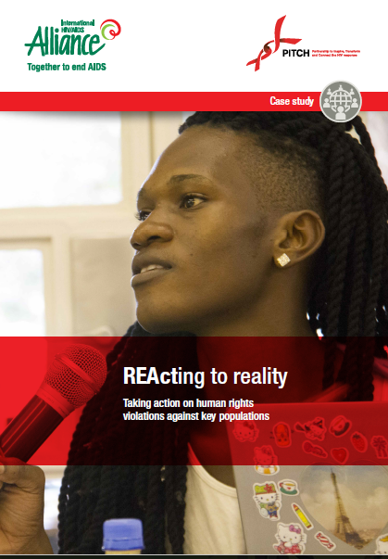
Case study
PITCH – ‘REActing to reality’
“REAct is important in Nigeria because it will aid civil society organisations and other related networks to document and derive verifiable data of abuses: stigma, discrimination, threat to life, blackmail, extortion, arbitrary arrest and unlawful detention. REAct will redefine the process of information collation for LGBT-related human rights issues.”
Notes:
In September 2017, the Alliance held a REAct workshop that brought together representatives of LGBT organisations from Nigeria, Zimbabwe, Uganda, Kenya and Mozambique. The workshop strengthened their knowledge and skills in using and adapting REAcT, which will be part of their work under the Partnership to Inspire, Transform and Connect the HIV response (PITCH) programme.
This five-year programme strengthens the capacity of community-based organisations to advocate for equal rights, and
equal access to HIV and sexual and reproductive health services, for key populations. It builds skills and capacity to generate robust evidence, develop meaningful policy solutions and engage in effective advocacy.

Slide 16
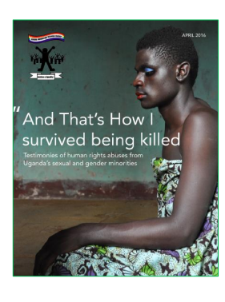
Advocacy
SMUG – “And That’s How I survived being killed”
“I am HIV positive and I have lived with it for a year now… One time I walked into a clinic near home and talked to the nurse about what was happening and I told her that I was HIV positive. Meanwhile, she started calling people to come and see ‘this rotten person’, so I had to walk out of the centre. I felt like committing suicide – so lost and confused.”

Slide 17
Advocacy
ATL and DAMJ – Rights to Equality (R2E) in Tunisia
Under Rights to Equality (USAID funded) programme, ATL and DAMJ, implementing partners in Tunisia working with LGBT people, used REAct to document human rights violations towards marginalised populations, including LGBT migrants coming from Sub-Saharan Africa. Since the beginning of the project in 2017, ATL has collected a total of 82 cases and DAMJ 104 cases.
ATL coordinated a workshop “Etre migrant en Tunisie” (To be a migrant in Tunisia), that took place on 20 September 2018. The workshop shed the light on successes but also challenges of working with the refugee and migrant populations in Tunisia, as well as of integrating them into the Tunisian society.
Notes:
What is coming out of the research in Tunisia are the issues of homelessness among Tunisian LGBTI, need for housing assistance among HIV+ migrants from Sub-Saharan Africa and among HIV+ Tunisian families.

Slide 18

Advocacy
MENARosa – Stories from women living with HIV in the Middle East and North Africa
One of the key issues gathered by the MENA Rosa focal points relates to experiences of gender-based violence (GBV).
Following this work, the organisation is now collaborating with Frontline AIDS and UNAIDS to implement LEARN-MENA, a USAID-supported programme that explores and documents the links between GBV and HIV for a diverse range of women in the region, as a way to identify and drive responses and influence decision makers.
Notes:
MENA Rosa operates through a peer-led model, identifying women involved in its network to become peer educators and outreach workers who help women in similar situations. In 2017, Frontline AIDS supported MENA Rosa to train focal points in all countries covered by the organisation (including Sudan, Morocco, Tunisia and Yemen) on REAct, (Rights, Evidence, Action), a system for monitoring and responding to violations that impact on people’s sexual and reproductive health and rights and their ability to access HIV services.

Slide 19
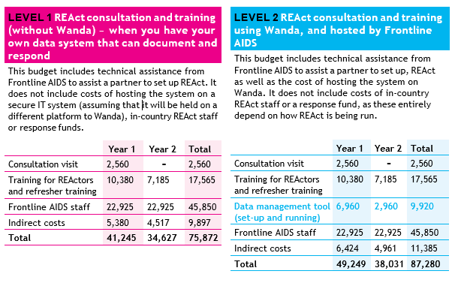
How much will it cost to set up REAct?
Notes:
The following scenarios illustrate a range of models for implementing REAct, both with and without using Wanda. The budget figures presented are not definitive, as much will depend on the local context, but aim to give you an approximate idea of the relative cost of different models.

Slide 20
Additional budget lines
REAct coordinator and REActors
Emergency fund
Training of trainers
Equipment
Supplies
Server hosting costs
Notes:
Additional budget lines
Additional budget lines that must be budgeted for include the following:
REAct coordinator and REActors:
Budget should be allocated for a REAct coordinator to provide oversight and guidance in country. The number and level of effort of the REActors depends on how many REAct implementing organisations will be involved.
Emergency fund:
Budget should be included for responding to emergencies, as well as for legal assistance, psychosocial support and medical assistance.
Training of trainers: If the project will be rolled out to a large number of implementers in-country, then training of trainers should be included in the budget.
Equipment:
The implementer’s budget should include cost of laptops for REAct coordinators and equipment for REActors. This will depend on the number of REActors and coordinators.
Supplies:
It may also be necessary to budget for supplies such as rapid HIV tests, condoms, lubricants and other supplies.
Server hosting costs
If the system is not held within Wanda, the implementer’s budget should include hosting and customisation costs. This will vary depending on the size of the programme and the exact specifications.

Slide 21

“I myself, am an activist who has faced persecution. I can show groups from across Africa that, through REAct, we have a system and it works. The more countries that use REAct, the more we can combine our evidence and the more we can combine our response.”
Research and Documentation Manager, Sexual Minorities Uganda (SMUG)

Slide 22
T3 UNDERSTANDING OUR CONTEXT
Welcome and Introduction to REAct
Under-standing our context
Human rights principles and responses
Collecting evidence
Managing information
Next steps
Notes:
T3.1 Human rights in our country
Ask directors of local human rights organisations to give an overview of their work and the challenges they encounter because of laws and policies affecting their community.
Or
Ask participants to break into their population groups and brainstorm the existing rights-related barriers to enabling acces to HIV related and other health services, and the role of law and policy and the programming work that is being done to address the human rights barriers in their country.

Slide 23
T3.2 Activity
Human rights issues in the community
Notes:
Ask participants to individually think of a beneficiary within the community who faces human rights-related issues. This person will form the basis of a character to be used in examples and role plays throughout the workshop.
2 options to choose from:
(Long activity) Participants develop their own client profiles:
In key population groups, ask participants to choose one of the characters who represents a ‘typical’ client. Draw the character on a sheet of flip chart paper. Then ask them to list on Post-it notes the human rights-related issues faced by their character – one on each Post-it note. Stick these around the character to show the types of incidents.
Ask participants to think about who is causing each problem, and explain that we refer to these people as the perpetrators.
Ask participants to briefly introduce their character, providing four priority issues their character encounters as well as the perpetrators. Explain that we will be returning to their characters throughout the workshop. Stick the characters up on the wall.
2) (Short activity) Scenario exercise:
Distribute the scenarios that have been developed and ask Participants to discuss the challenges that this person is experiencing, their rights, and their understanding of the role of government in addressing these.
NOTE
This activity can be traumatising for trainees if they have experienced similar situations. Be alert to signs of distress and be ready with an alternative, such as handouts with pre-prepared scenarios instead. The resource Self-care and prevention of burn out among activists – tools for everyday life may also be useful, for trainers as well as participants: https://frontlineaids.org/ resources/self-care-and-prevention-of-burn- out-among-activists-tools-for-everyday-life/

Slide 24
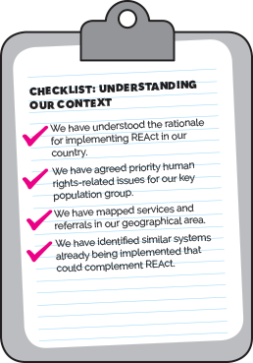

T3.3 Mapping responses
Group work exercise
Notes:
Distribute flip chart paper and markers. Ask participants to draw a map of the area they work in, including their organisational responses. Make sure they include the services they provide and referrals they make, together with any partnerships with human rights organisations or those providing legal, health and other services specific to their communities. Then ask participants to give a brief overview of these in plenary.
Stick the maps up on the wall and give participants a few minutes to do a 'gallery walk' to look at them. If organisations are working in the same geographical areas, encourage them to add to their own maps any services they are not currently linking to.
In plenary, ask participants if they know of any systems being implemented that collect data on human rights violations and situations. Explain that REAct not only records information but also facilitates emergency responses and referral to appropriate interventions. Discuss how these systems might complement REAct, or vice versa.

Slide 25
T4
HUMAN RIGHTS PRINCIPLES AND RESPONSE
Welcome and Introduction to REAct
Under-standing our context
Human rights principles and responses
Collecting evidence
Managing information
Next steps
Notes:
Ensure all participants have copies of Unit R1 from the REAct Guide.
Materials: flip chart paper, markers, tape, post it notes, pens, notebooks, handouts with pre-prepared case studies, interview checklist card and referral card

Slide 26
T4.1 What are human rights?
Respect the human rights of all people, and to prevent, investigate and sanction violations committed by their officers
Protect the human rights of all citizens by taking all necessary measures to avoid the deprivation of their rights
Promote the respect of the human rights of all citizens without distinction
Notes:
What are human rights?
Human rights are basic universal entitlements that all people have because they are human. They are based on the idea that all persons are equal and entitled to be treated with dignity and respect, regardless of their race, sex, gender, age, disability or any other characteristic. Human rights apply to all people throughout the world at all times.
Human rights give people the freedom to choose how they live, how they express themselves, and what kind of government they want to support, among many other things. They also guarantee people their basic needs, such as food, housing, health care and education. By guaranteeing life, liberty and security, human rights protect people against abuse by those who are more powerful.
State institutions and representatives, including government officials, policemen and women, army personnel, prison officers, civil servants, the judiciary, political authorities, and medical or education personnel in state-run facilities, have
the obligation to fulfil the rights of all their citizens without discrimination. In order to do so, states have a responsibility to:
respect the human rights of all people, and to prevent, investigate and sanction violations committed by their officers.
protect the human rights of all citizens by taking all necessary measures to avoid the deprivation of their rights.
promote the respect of the human rights of all citizens without distinction
WHAT ARE HUMAN RIGHTS VIOLATIONS?
Generally, a human rights violation can only be committed by a state. Human rights violations can occur through:
Failing to respect human rights: This is an act committed directly by the state that is contrary to its human rights obligations (for example arbitrarily depriving someone of their freedom or torturing them).
Failing to protect human rights: This is an indirect violation committed by the state by omission (i.e. by not providing protection against systematic abuse committed by one group against another, or by not promoting the rights of all citizens). Omission is negligence in performing the requirements of national or international law relating to the protection of human rights. In the case of omission, the actual hurt can be committed by common citizens. The state has a responsibility to act to stop these incidents and provide protection to the victims. If the authorities don’t do so, they are violating the rights of the victims by their omission.
Failing to promote or fulfil human rights: It is the state’s duty to ensure that laws that protect everyone without discrimination are enforced. The state must also promote these rights to ensure that all its citizens are aware of them and how they can claim them effectively. The state and its representatives must ensure that the mechanisms for denunciation and redress are in place for all citizens to access. Failure to do all these (for example by failing to undertake campaigns against social discrimination targeting a particular ethnic group or sexual minority) constitutes a violation of the state’s responsibility to promote the human rights of all its citizens. This includes state institutions and representatives, such as government officials, policemen and women, army personnel, prison officers, civil servants, the judiciary, political authorities, and medical or education personnel in state-run facilities.
The idea of human rights is not a modern one. There are references to human rights in historical documents across the world. Some people argue that human rights are not universal. They say that they are a foreign concept that cannot be forced on countries. They argue that each country is free to determine its own national values, rules, norms and laws. However, in most cultures and religions, there are ideas that describe respect for our fellow human beings. For example, stories, myths and legends illustrate that we are all human, with the same needs and desires, supporting the notion that we should treat everyone in the way that we would like them to treat us.
Human rights have been enshrined in the Universal Declaration of Human Rights and codified in a series of international human rights treaties ratified by states, and in other instruments. There are also regional human rights instruments, and most states have adopted constitutions and other laws that formally protect basic human rights and freedoms.
The underlying feature of human rights is the identification of rights holders who, because they are human, can claim certain entitlements; and duty bearers, who are legally bound to respect, protect, promote and fulfil the entitlements of rights holders. Human rights law obliges the state and other duty bearers not to infringe or compromise the fundamental freedoms and rights of people, and means that the state has a duty to realise rights for all
National, regional and international human rights laws guarantee rights, and when these laws are not upheld this can result in human rights violations and rights-related barriers to HIV services.

Slide 27
T4.2
WHY ARE HUMAN RIGHTS RELEVANT FOR OUR WORK?
Notes:
Ask participants in pairs or threes to brainstorm any links they can think of between human rights violations and their impact on HIV and health. Gather feedback in plenary.

Slide 28
What are the human rights-related barriers to accessing services?
They are obstacles that make it difficult or impossible for people to access prevention, care and treatment services.
Stigma and discrimination
Gender inequality and gender-based violence
Punitive policies, practices and laws

Slide 29
Group work – give examples of rights-related barriers for these groups
People who inject drugs
Migrants
Refugees and asylum seekers
Young people
Gay men and other men who have sex with men
Transgender people
Choose a group to discuss
In your group, identify some examples of rights-related barriers experienced by the group you’ve chosen and how these barriers affect their ability to access health services?
Notes:
Ask participants in pairs or threes to brainstorm any links they can think of between human rights violations and their impact on HIV and health. Gather feedback in plenary. Refer participants to R1.2 in the REAct guide and go through the examples in Table 1. Check understanding by asking for volunteers to explain in their own words how human rights are directly relevant to their community and/or to the work of their organisation.

Slide 30
TABLE 1: EXAMPLES OF HUMAN RIGHTS VIOLATIONS, LEADING TO BARRIERS TO HIV-RELATED SERVICES
HIV-related human rights violations | Impact on HIV and health
Marginalised people that are vulnerable to HIV are discriminated against by healthcare providers | Marginalised people are denied access to prevention, treatment, care and support services. The results may include: they and their sexual partners are at increased risk of HIV people living with HIV do not get treatment HIV-positive pregnant women do not access prevention of mother-to-child transmission services, therefore putting their babies at risk.
Laws criminalise marginalised people; for example, the anti-homosexuality bill in Uganda | Increased stigma and discrimination; for example, men who have sex with men are afraid to access health services.
People living with HIV are discriminated against and unfairly dismissed in the workplace because of their HIV status | Workplace discrimination against people living with HIV means that HIV-positive employees cannot earn a living. The results may include: general financial instability for the family inability to pay for transport to services inability to pay for antiretrovirals and other HIV-related services.
Laws and policies in some countries prohibit adolescents, children and marginalised populations from getting appropriate HIV information and education | Affected populations do not receive appropriate HIV information so are less able to prevent HIV infection or access services.

Slide 31
TABLE 2: THE LINK BETWEEN HUMAN RIGHTS AND HIV
Human right | HIV-related rights violations | Impact on HIV, health and human rights
Every person has the right to fair labour practices | People living with HIV are discriminated against and unfairly dismissed in the workplace on the basis of their HIV status | Workplace discrimination denies employees with HIV the ability to earn a living when they may need income most. This increases the impact of HIV on their lives
Everyone has the right to freedom of assembly and association | In some countries people living with HIV and other key populations are denied the right to organise and form support organisations | Where laws or practices prevent key populations from organising, they lose an important source of information and support to promote their health
Every person has the right to freedom of movement | HIV should not be treated differently from other diseases with regard to immigration, long-term residency or short-term visits to any country | Countries that require information about HIV status, that deport people who are living with HIV, and who treat HIV differently from other diseases, can undermine access to healthcare, information and other human rights
Every person has the right to access to information | Laws and policies in some countries prohibit adolescents, children and key populations (e.g. men who have sex with men) from getting appropriate HIV information and education | Affected populations do not receive appropriate HIV information so they are less able to prevent HIV infection or access available services

Slide 32
T4.3
WHAT DO YOU CONSIDER TO BE RIGHTS VIOLATIONS?
Notes:
Prepare a board (or sheet of flip chart paper) in advance with two headings: Human rights violation and Not a human rights violation.
Ask participants to think back to the character they created (or the scenario they used) in Unit T3 and write on three separate Post-it notes three situations their character might encounter that they consider to be human rights violations. Place the Post-it notes in the middle of the board. In plenary, encourage the group to decide whether they think each situation is a human rights violation or not, and place each Post-it note under the heading agreed by the group. (You should not intervene to ‘correct’ their answers at this point – simply find out the consensus of the participants.)
Alternative: ask participants to picture an imaginary line down the centre of the room, with one side representing human rights violation and the other side not a human rights violation. As each Post-it note is read out, participants should move to the side that they believe corresponds to that situation

Slide 33
TABLE 3: EIGHT KEY HUMAN RIGHTS-RELATED HIV PROGRAMMES
 | The programmes | How can you use them?
1 | Stigma and discrimination reduction programmes | These programmes help to address actionable causes of stigma and discrimination, and to empower people affected by HIV and AIDS.
2 | HIV-related legal services | These programmes facilitate access to justice and redress in cases of HIV-related human rights violations.
3 | Monitoring and reforming laws, regulations and policies relating to HIV | Programmes to monitor, review and reform laws help to create laws and policies that support rather than block, access to HIV and health services.
4 | Legal literacy (‘know your rights’) | Legal literacy programmes teach those living with HIV and key populations at higher risk of HIV exposure about laws, their rights and how to enforce them.
5 | Sensitisation of lawmakers and law enforcement officials | These programmes sensitise lawmakers and law enforcers about how the law impacts on HIV and about the rights of marginalised populations, in order to support protection of rights and access to services.
6 | Training for healthcare workers on human rights and medical ethics related to human rights | Training programmes improve healthcare workers’ understanding of their own and their patients’ rights, and help to reduce stigma and discrimination in the health sector.
7 | Reducing discrimination against women in the context of HIV | These programmes address gender inequality and gender-based violence as both causes and consequences of HIV infection.
8 | Core community-led human rights-related responses to HIV | These programmes are core civil society organisations and community-based organisations interventions, including crisis response (reacting to emergencies regarding security and protection from exposure of individuals and their organisations); effective human rights-related advocacy; and the production of evidence to inform human rights programming and advocacy.
Notes:
Human rights-based HIV programmes and interventions
Go through the eight suggested rights-based HIV and health programmes.
Break into groups; participants can be grouped randomly. Assign each group one or two of the human rights-related HIV programmes. Ask the groups to suggest examples of interventions and activities that would fall under that programme.
Gather feedback in plenary.
Break into client groups and return to the maps of services and referrals that participants created for their communities in T3.3. Ask them if they want to add anything to their maps. Give them a copy of the referral card and ask them to complete it. Suggest they ask other groups about their services and referrals if appropriate.
Alternative session is to do the following:
Break into groups and ask each group to invent a character and a scenario that is typical for their clients/communities (or you can use pre-prepared scenarios if you prefer).
Ask them to discuss what each character needs in terms of:
emergency responses.
HIV-related programmes and interventions in the longer term.
In a large group, ask each small group to introduce their characters and scenarios, saying which responses they would recommend

Slide 34
Refer to R1.3 What is a human rights violation?
A human rights violation can only be committed by a state.* Human rights violations can occur through:
Failing to respect human rights: This is an act committed directly by the state that is contrary to its human rights obligations (for example arbitrarily depriving someone of their freedom or torturing them).
Failing to protect human rights: This is an indirect violation committed by the state by omission (i.e. by not providing protection against systematic abuse committed by one group against another, or by not promoting the rights of all citizens). Omission is negligence in performing the requirements of national or international law relating to the protection of human rights. In the case of omission, the actual hurt can be committed by common citizens. The state has a responsibility to act to stop these incidents and provide protection to the victims. If the authorities don’t do so, they are violating the rights of the victims by their omission.
Failing to promote or fulfil human rights: It is the state’s duty to ensure that laws that protect everyone without discrimination are enforced. The state must also promote these rights to ensure that all its citizens are aware of them and how they can claim them effectively. The state and its representatives must ensure that the mechanisms for denunciation and redress are in place for all citizens to access. Failure to do all these (for example by failing to undertake campaigns against social discrimination targeting a particular ethnic group or sexual minority) constitutes a violation of the state’s responsibility to promote the human rights of all its citizens.
* This includes state institutions and representatives, such as government officials, policemen and women, army personnel, prison officers, civil servants, the judiciary, political authorities, and medical or education personnel in state-run facilities.
Notes:
****Return to the list of situations from the previous activity above, that the group decided are/are not human rights violations (i.e. that are/are not the responsibility of the state) and reopen the discussion. If the group has changed their opinion about how to categorise any of the situations, discuss why and then move the Post-it note under the alternative heading. Highlight that the responsibilities of states are not always obvious, but that participants should ask:
Did the state fail to respect the rights of an individual?
Did the state fail to protect the rights of an individual?
Did the state fail to promote/fulfil the rights of an individual?

Slide 35
Case study exercise (optional)
Refer to the case studies provided
What are the rights of the individual/group in these cases?
What are the duties of the state in these cases?
Has the state executed its duty? In other words, have any rights been violated, or just reasonably limited? Explain.
Notes:
Make sure you have copies of the case studies.

Slide 36
OPTIONAL SECTION IN THE RIGHT TO HEALTH

Slide 37


Notes:
Optional slides – discuss the right to health as central right

Slide 38
Accessibility
Everyone should be able to access health care, regardless of who they are. It should be free/ affordable and comprehensive. Services must be available to everyone regardless of where you live
Availability
The health system infrastructure should be adequate – buildings, medicines, diagnostics.
Acceptability
Health care services should be respectful and non-non-discriminatory and treat everyone equally, fairly and with compassion
Quality
Medical staff should be sufficiently trained and available
Respect for medical ethics, confidentiality and the right of the patient to participate in their health care
Health services must be appropriate for what is needed, and of good quality, including trained personal
It must be safe, and patient-centred.
Accountability
Duty bearers should be held accountable for meeting human rights obligations in the area of public health, including through the possibility of seeking effective remedies for breaches such as, for example, the denial of treatment.
Participation
The beneficiaries of health care services, facilities and goods should have a voice in the design and implementation of health policies which affect them.
Notes:
Optional Slide – what is the right to health?

Slide 39
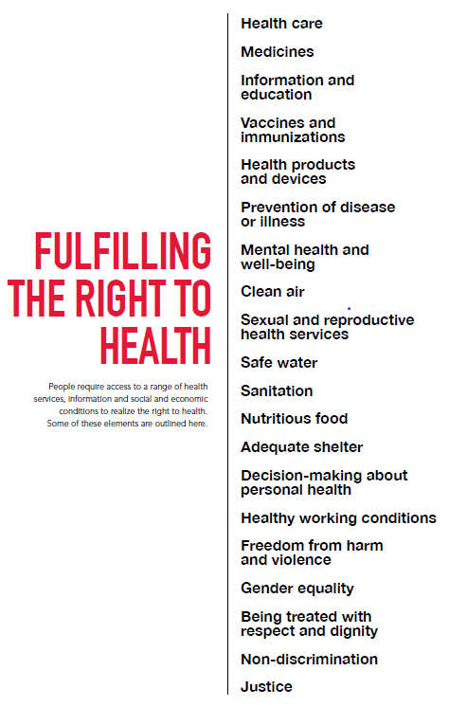
Notes:
Interdependence of the right to health and others – Rights to health cannot be fulfilled without fulfilling others

Slide 40
State duty to the right to health
International Covenant on Economic, Social and Cultural Rights – states must progressively realise the right to health to the maximum of their available resources.
It distinguishes between unwilling states from unable states.
However immediate obligations:
Prohibit and eliminate discrimination
Obligation to ‘take steps’.
Do not go backwards after progress made (non-retrogressive measures).
Meet bare minimum, no matter what. Introduce low-cost and targeted programmes to assist those most in need so that its limited resources are used efficiently and effectively.
Notes:
What is the duty of the state to the right to health?

Slide 41
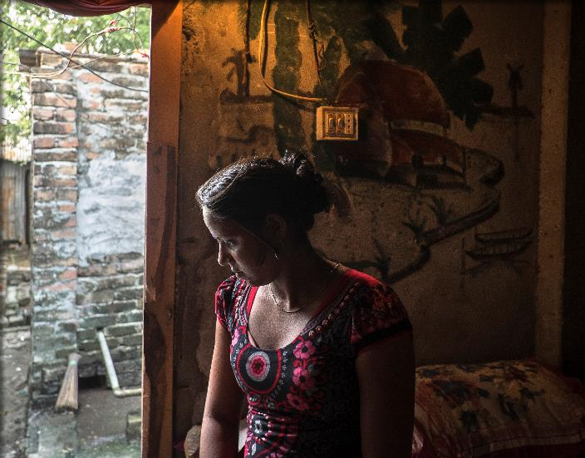
Global recognition for rights responses to HIV
‘…it will not be possible to Fast-Track the HIV response and end the AIDS epidemic without addressing human rights.
Human rights barriers – including stigma and discrimination, violence and other abuses, negative social attitudes and legal obstacles – contribute to vulnerability to HIV among key populations and marginalised groups limiting their access to prevention, testing, treatment and care services.
Fast-Track and human rights, UNAIDS (2017)

Slide 42


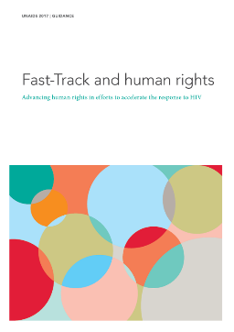


Global policy and guidance
Development of global guidance
2016 UN General Assembly
Political Declaration on HIV and AIDS

Slide 43
T5
COLLECTING EVIDENCE
Welcome and Introduction to REAct
Under-standing our context
Human rights principles and responses
Collecting evidence
Managing information
Next steps
Notes:
Materials needed
Flip chart, markers, tape, post it notes, pens, notebooks, copies of Unit R2, safety and security guidance, REAct template, consent form, interview checklist and referral card
Plenary
Ask participants to brainstorm the principles that they think should guide interviewers when collecting sensitive information. Supplement or prompt as needed until all the main points have been covered.
PowerPoint REAct workshop presentation
Discussion
Ask participants if they have had had experience of carrying out human rights interviews. If so, invite them to share any difficulties or challenges they have encountered and how they dealt with them.
Distribute copies of the safety and security guidance and ask participants to go through it in pairs or threes. What do they find most useful? Do they have further suggestions to add based on their local experience?
Distribute copies of the consent form and interview card and referral template, and discuss their content.

Slide 44
What evidence is it that we are collecting?
Individual case management
  Organised by beneficiary/person
  Allowing for multiple cases experienced by a single individual and allows for follow up
Interviews with beneficiaries
  Direct – Face to face accounts
  Semi-structured
Situations impeding or restricting the access of beneficiaries to HIV and health services
Wider human rights violations
Non human rights-related emergencies

Slide 45
T5.1 Interviewing principles
Do no harm
Transparency
Confidentiality
Informed consent
Security
Accuracy/ Objectivity
Impartiality
Sensitivity to diverse identities – gender, age, race, culture, sexual orientation etc

Slide 46
Interview techniques
DO’s
Allow the interviewee to tell the story at their own pace
Make notes for reminders
Ensure interview space is safe, secure and private
Obtain as much relevant detail as possible
Ask open ended questions and clarify information
Build a rapport, express sensitivity, compassion and non-judgment
Be aware of non-verbal signals
Respect confidentiality
Make sure consent is informed
DON’Ts
Do not interrupt the interviewee
Do not push the interviewee and put words in their mouth
Do not discuss the case with non-relevant parties
Do not judge, criticise or condemn
Get too caught up recording information and forgetting about the person telling the story

Slide 47
The interview part 1: Setting, safety and informed consent
How to prepare
Ensure at least 40 minutes are available for the interview
Materials/equipment
Setting – private and comfortable with little chance of interruption
Content
Do not keep the interviewee waiting
Starting the interview – covering the basics
Introduce yourselves and begin to build rapport
Ensure informed consent – ensure they have the information that they need before making an informed decision to share
Explain confidentiality - clarifying who will have access to their story; clarifying the procedure for follow-up if needed and how the data will be used in future
Manage beneficiary expectations – clarifying what you may or may not be able to provide, the interview format

Slide 48
Build rapport and a safe space for sharing
Introduce yourself and allow the beneficiary to do the same
Show interest in where they are coming from
Make sure the beneficiary knows that they do not have to do anything they don’t feel comfortable doing
Recognise and acknowledge difficulty
Demonstrate empathy
Encourage emotional expression supportively
Actively listen
Avoid assumptions – seek clarity where not clear
Practice self-control over shock and anger

Slide 49
Enabling informed consent
The beneficiary needs to be provided with enough information about their case in order to give consent:
In order to give informed consent, the beneficiary will need to know the following key information:
How secure is my data?
Will my case be anonymous?
How will I be followed up with if you have my personal contacts? What does that mean for my anonymity?
Who will have access to my data or with whom will it be shared?
How will my data get used?
What kind of support will I be able to receive from you?

Slide 50
Interview practice
Part 1: Meeting the beneficiary for the first time
Role play 1
In pairs, practice the first phase of the interview, taking turns to be REActor/client. Once you’ve each had a chance to go, we will ask a few volunteers to share their practice with us.
In your role play, demonstrate:
Introductions and rapport building skills
Enabling a safe, private environment for sharing
Enabling Informed consent to the interview (emphasis on confidentiality and data sharing and security) and signing consent forms.
Explaining the interview process
Explaining the REAct programme and what it can offer to the beneficiary (clarifying expectations)

Slide 51
Interview practice
Part 2: Conducting the interview
Asking open ended questions
What?
What happened?
What support would you like from us?
Where?
Where did it happen?
Where were you hurt?
Where did you go for help?
When?
When did the event happen?
When did you go for help?
How?
How has the situation affected your ability to access HIV and health services?
Who?
Who was involved?
Who were you with?
Why?
Why did you think you were treated like that (discriminated against, denied services etc)

Slide 52
Interview practice
Part 3: Concluding the interview
Make sure you:
  Have covered the questions in the questionnaire
  Are satisfied with the recount of the case
  Clarified any outstanding queries
  Have the relevant information to recommend responses
  Thank the interviewee
  Reaffirm confidentiality
  Discuss next steps
  Agree on a follow-up plan
    Actions
    Responsibilities
    Dates and times

Slide 53
Interview practice
Part 2: Conducting and concluding the interview
Role play 2
In pairs, practice conducting and concluding the interview. You can either use a case study of your own, or one of the scenarios used earlier. Take turns to be REActor/beneficiary. Once you’ve each had a chance to go, we will ask a few volunteers to share their practice with us. Use the Checklist to guide you.
In your role play, demonstrate a few of the following:
Do-no-harm principles
Asking open ended questions (what, where, when, how, why, who)
Active listening skills
On-going non judgmental verbal and non-verbal cues
Ability to document and listen at the same time – did you get enough information to complete the react template?
Understanding what the beneficiary wants, facilitating their decision making
Providing suggestions, not forcing decisions on beneficiary
Clarity and agreement on follow-up

Slide 54
After the interview
Enter the information into the system as soon as possible
Upload the data on the server as soon as possible
Destroy any notes and voice recordings of the interview
Carry out the action plan

Slide 55
What to do after the workshop
Activity | Outcome | Responsibility
Broader community consultation, if necessary | Validation from identified key population groups that the REAct questionnaire appropriately captures the priority areas needed for monitoring and response | Coordinating Organisation and Implementing Organisations
Final revisions to template |  | REAct@Frontline AIDS, Coordinating Organisation
Draw up and sign MoUs/contractual agreements | Clear roles and responsibilities are established for Coordinating Organisation and CBOs, including financial arrangements | Coordinating Organisation and CBOs
Establish REAct Committee | Advice is available on REAct implementation, small grants scheme and responses/programming | Coordinating Organisation and CBOs
Complete Wanda set-up and test | Wanda is working correctly and problems have been overcome | REAct@Frontline AIDS, Coordinating Organisation, CBOs
Distribute funds to CBOs | CBOs have resources to implement REAct | Coordinating Organisation to CBOs
Complete workshop report | There is a record of key learnings and recommendations for REAct implementation and processes | Coordinating Organisation
Implement REAct |  | Coordinating Organisation, CBOs

Slide 56
T6
MANAGING INFORMATION
Welcome and Introduction to REAct
Under-standing our context
Human rights principles and responses
Collecting evidence
Managing information
Next steps

Slide 57

PAPER/EXCEL
VS. ONLINE SYSTEMS

Slide 58

Current documentation practices
How do you document your human rights work now?
What are the advantages of collecting monitoring data on paper or in Word/Excel documents?
What are the disadvantages of collecting our monitoring data on paper or in Word/Excel documents?
What are your questions or concerns about collecting data in an online system?

Slide 59
INTRODUCTION TO WANDA
Notes:
Wanda is the online monitoring and reporting tool that is most frequently used by REAct to document and analyse cases of human rights violations and abuses. Wanda can be accessed on any Internet browser on a desktop computer or laptop, as well as through an app using an Android mobile phone or tablet.
However, using Wanda is optional, as a coordinating organisation may already have an alternative monitoring and data management system, or wish to design their own instance of DHIS2. The table on page 38 gives more detailed information about the characteristics of DHIS2.
If laptops are available at the workshop, REAct Implementing staff can have hands-on training, and Wanda can be set up and configured during the workshop. When Wanda is accessed through laptops, the recommended browser is Google Chrome. It is good practice to advise all participants to download Google Chrome on their laptop prior to the workshop.
Participants who have an Android smartphone can also access Wanda through the following free App, which can be downloaded from the Google PlayStore: DHIS2 Android Capture.
The length of time needed to train on Wanda will depend on the technical capacity and experience of the implementing organisation staff. A minimum of one day should be spent on the training in this unit – see suggested timing in the table opposite.

Slide 60

The move to Wanda
DHIS2 is an open source software platform enabling governments and organizations to collect, manage and analyse data in the health domain and beyond.
A version of DHIS designed to manage projects and also track and document cases of human rights abuses and violations.

Slide 61

We want to reduce this…

Slide 62


We will try to avoid this…

Slide 63

Hopefully you will feel like this!

Slide 64
Why DHIS2?
Security and data sharing control:
Access:
Case management:
Affordability:
User friendliness:
Sustainability:
Well established and long running system with very wide adoption globally
Infinitely scalable.
No licenses required
Can be used with basic training
Offline features
Mobile & computer
Hosting options: choose own host or contribute % to Frontline AIDS instance of Wanda
Free open source software
Analysis and reporting:
Pre-set & custom reports
Has data visualisation.
Basic and sophisticated analyses.
Two-factor authentication, pin protected
Offline and on-line use
Can store and analyse other surveys
Can track cases anonymously
Can track follow up actions.
Links needs to providers
System & data management features:
Customisable forms in different languages and scripts and translation
User friendly interface
Visual branding
Free upgrades
Interoperable outputs
Has required/optional data field settings.
attachments
Can set different roles with different access and functionality.
Has user change log.
Has data validation rules.
Built in encryption
Cloud-based system

Slide 65

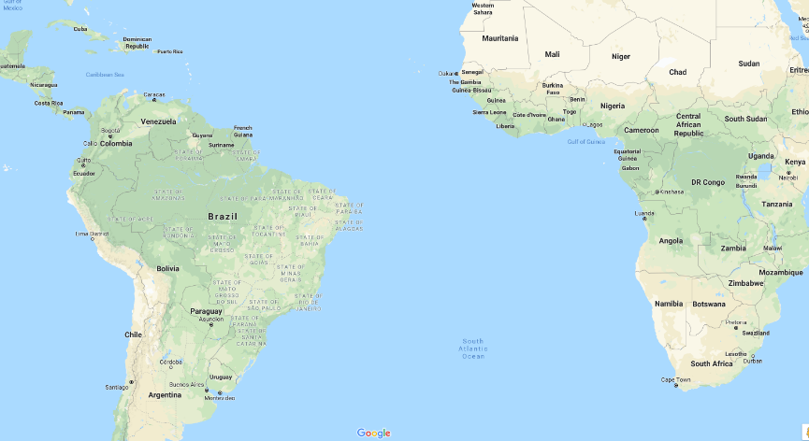
Who was Wanda Fox?

Slide 66
HOW CAN WE KEEP OUR DATA SECURE?

Slide 67
15 minutes: Discussion
Break into groups and come up with three points on how we can keep our data secure. Each group present back

Slide 68
Security features of Wanda
Data is encrypted when it goes from your browser to the server (SSL encryption)
Storage encryption - if anyone got into the server they couldn’t browse the data
Virtual private network (VPN) – private cloud service that isolates Wanda from other users on the server
Password protected, with possible two-factor authentication functionality
Session timeout
Because Wanda is web-based:
No loss of data due to power cuts
Not susceptible to computer viruses/hard drive corruption issues

Slide 69
THE REACT TEMPLATE

Slide 70
REAct template
Traceable information (Profile)
Case details (multiple allowed)
    Type of incident
    Perpetrators
    Responsibility of the state
Programmatic
Policy recommendations
Responses provided and updates
Attachments

Slide 71
Adapting the REAct template
Use the base template to discuss:
    Relevancy
    Use of language
    Customising lists
      Type of incident
      Perpetrators
      Responses
Template finalisation will be done after the workshop with support from the REAct team
The template will be formatted for use in Wanda

Slide 72
ACCESSING WANDA

Slide 73

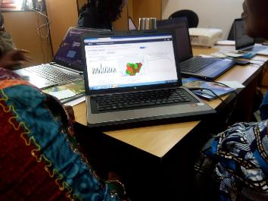
Where can you access Wanda?
Each type of method has offline and online capabilities

Slide 74
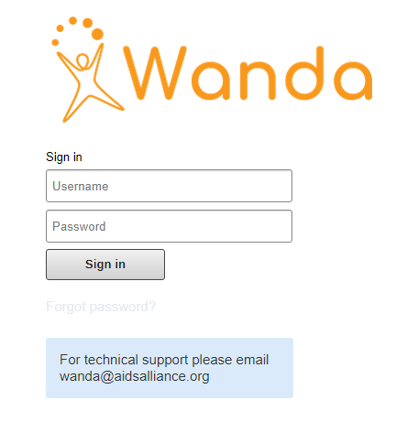
Using the system – computer
Got to: https://train.wanda.aidsalliance.org
If you’ve typed it in correctly, this is what you should see.
    Forgot your password?
    To retrieve and create a new password you will need an email address
    If you experience any other issues while using Wanda, use the email address provided to send your questions

Slide 75




×
Using the system – mobile
✓
×
Notes:
You can also try to log in through the mobile app (but only if you had an Android device)

Slide 76
Practice logging in

Slide 77

Navigating Wanda
Notes:
Explain: Dashboard
Once you have successfully logged in you will see the Wanda dashboard. Dashboards are intended to provide quick access to different analytical objects (maps, charts, reports, tables, etc) to an individual user. Dashboards can also be shared with user groups. Once you start creating graphs/tables they can appear here.
[move to browser]
Explain: Apps
Wanda consists of various apps (major components) which each have specific features, such as data entry, reporting, dashboard. You can access these from the top menu under Search Apps or the square symbol. Under profile, details relating to your user account, general user settings and information about Wanda can be found.
To move to a new app click in the Search App field, or click on the square symbol - a sub-menu with additional items will then appear. Click on the item you would like to open.
When you have finished your Wanda session we recommend that you log out before closing the browser. Use the log out link in the upper right corner and you will be returned to the log in screen.
The main applications in Wanda are highlighted below:
Tracker Capture: the tracker supports management, data collection, and analysis of transactional or disaggregated data.
Pivot Table: this is tool that allows the user to reorganise and summarise selected columns and rows of data in a table to obtain a desired report. The reorganised and summarised data is used for analysis and can also be downloaded as tables.
Event Report: this app can be used to analyse events in two types of reports:
Aggregated event reports: By selecting aggregated values from the top-left menu, the user can create pivot tables with aggregated numbers of events/activities. Users can also do analysis based on a range of dimensions i.e. gender or age.
Individual event reports: this generates a list of all the events. By selecting events from the top-left menu, the user can run searches or queries for events based on a flexible set of criteria. The report will be displayed as a table with one row per event.
Event/Data Visualiser: this app presents data based on events in a pictorial or graphical format so as to visually understand the data and identify new patterns or trends. The charts/graphs created through this app can also be downloaded for further use and dissemination.
Dashboard: this is the part of the home screen that is customisable and interactive. Tables and charts are organised in a way that is easy to read and navigate for the user. The user can also add tables and charts they create and save to their dashboard to refer to when required.

Slide 78
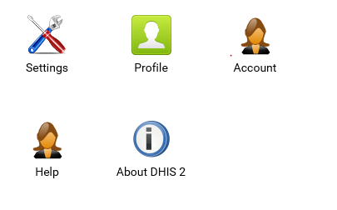
User profile
Notes:
With profiles, users can alter the appearance of their instance of Wanda and change the interface language. Users can also enter information into their "Profile".
To access the user settings menu, select the bubble with your initials in it, and click on the Profile app.

Slide 79
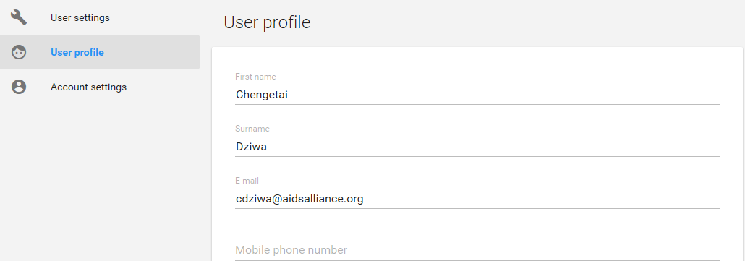
Editing data
Notes:
Users can choose to enter more data, such as their email and phone number, job title, gender, birthday, etc into their profile.

Slide 80
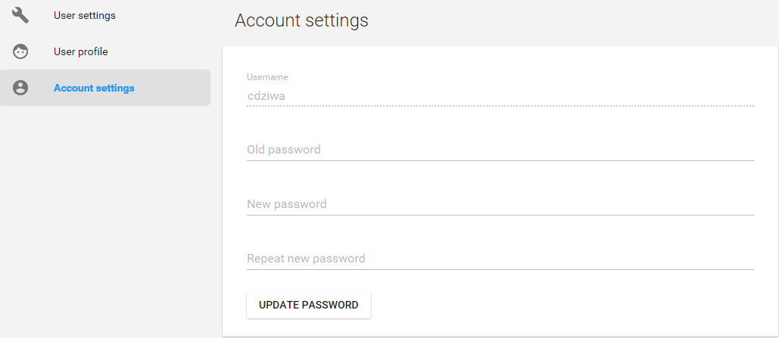
User profile: practice
Practice changing your password and adding details about yourself
IMPORTANT: PASSWORDS
Combination of letters and numbers
At least one capital letter
At least one special character (e.g. =!?*%&)
At least 8 characters long

Slide 81
ENTERING HUMAN RIGHTS DATA

Slide 82

Using computers
From the Apps menu, click the Tracker Capture icon.

Slide 83
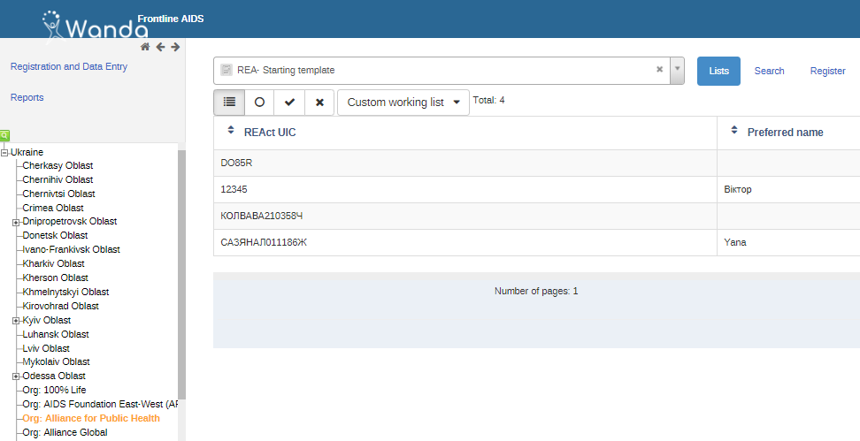
Registering a client
From the hierarchy tree on the left, click on the relevant Organisation Unit – the only option you should be able to see is linked to where your organisation is operating

Slide 84

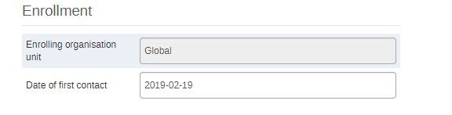
Registering a client
From the Tracker Capture app, select the REA- Starting template to register a client.
Click Register.
Enter the Date of first contact when the client came forwards with their story

Slide 85
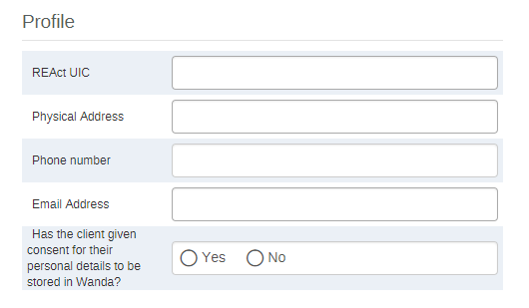
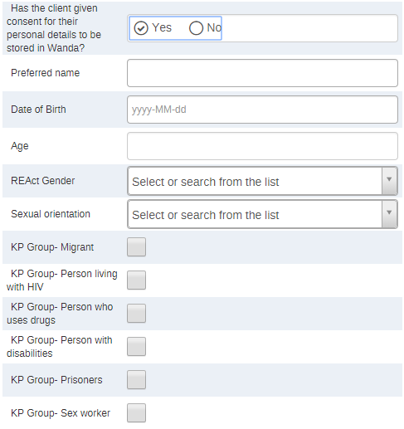
Registering a client
Enter all the necessary information in the profile of the client in the data entry form.
Traceable information
Personal information

Slide 86
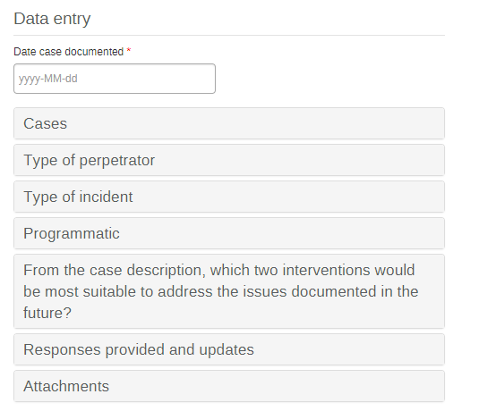
Registering a client
Enter information pertaining to the case in the following sections (click on each section to reveal the questions):

Slide 87
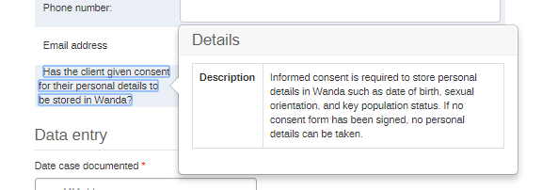
Registering a client
NOTE: By clicking on any of the data fields, further guidance can be viewed:

Slide 88
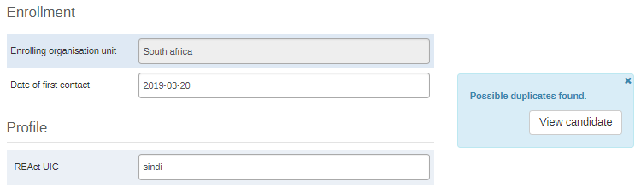
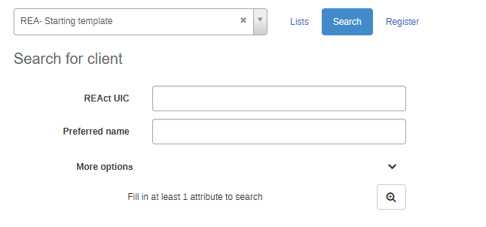
Search for a client
Duplicates in the system will immediately be flagged.
In addition, you can also search for existing clients in the system, perhaps to update case information.

Slide 89
Registering a client
Click either the Save and continue to finish or Save and add new to add another client

Slide 90
Practice entering data
Notes:
Use case studies, show what a good example looks like

Slide 91
REPORTS, ANALYSIS AND DASHBOARDS

Slide 92
Analysis of reach
1. REACH
Number of clients registered (# and %) | Age
 | Gender
 | KP
Number of cases reported | Total as well as disaggregated by perpetrator (state and non-state) and type of incident (# and %)
Location of cases | District/region/country

Slide 93
Analysis of responses
2. RESPONSES
Number of cases where a response was required
Type of responses provided (# and %) | Directly provided
 | Referral
 | Needed but not available
Type of services provided (# and %) | Disaggregated by response category
Amount spent on direct responses provided
Number of completed referrals (# and %) | Disaggregated by response category
Number of cases responding to project outcomes (# and %) | Not at all
 | Partially
 | Completely

Slide 94
Programmatic analysis
3. PROGRAMMATIC
Responsibility of the state (# and %) | Failure to respect
 | Failure to protect
 | Failure to promote
Recommended human rights-based programmes (# and %) | Stigma and discrimination reduction programmes
 | Legal services
 | Monitoring and reforming laws, regulations, and policies
 | Legal literacy (‘know your rights’)
 | Sensitisation of lawmakers and law enforcement officials
 | Training for healthcare workers on human rights
 | Reducing discrimination against women

Slide 95
NEXT STEPS
Welcome and Introduction to REAct
Under-standing our context
Human rights principles and responses
Collecting evidence
Managing information
Next steps

Slide 96
Checklist: Next steps
We have agreed how we are going to consolidate the information we collect through REAct.
We have created a REAct committee to decide on exceptional emergency responses, analyse the data, and agree the human rights programmes that will be needed as a result of that analysis.
We have agreed how regularly the REAct Committee will meet.
We have adapted and signed the MoUs between the coordinating and implementing organisations.

